Slide 1
Line Blockage Plans (List View)
Index based on Line of Route

Slide 2
Surbiton
Plan 1 | Surbiton - Hampton Court Junction Bournemouth Main Line
1.1 | DMSL blocked
1.2 | DMFL or UMFL blocked | ✔
1.3 | UMSL blocked

Slide 3
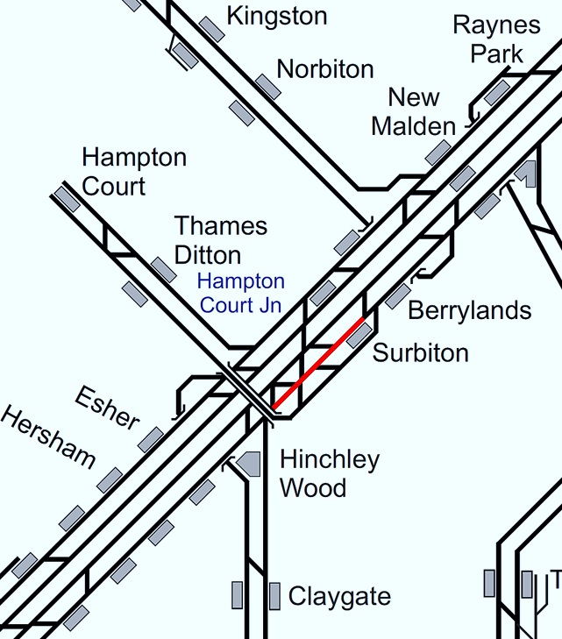
Plan 1.1 Surbiton - Hampton Court Junction
Bournemouth Main Line | Status: DMSL blocked
Principles of Service Alteration
If no access to New Line: 2Gxx Guildford (C) services diverted via Woking (call for crew purposes). 1Gxx Portsmouth via Cobham divert via Woking.
Alternative Passenger Journey
SWR bus service Surbiton to Effingham Junction. Local bus.
Information for Signallers
2Gxx Waterloo to Guildford divert via Woking with extra stop at Woking. 1Gxx Waterloo to Havant/Portsmouth via Woking.
Additional Information for Station Staff
SWR Bus Replacement Service all stations Surbiton to Effingham Junction.
Passenger Information
K3 bus Every 15 minutes, Surbiton to Hinchley Wood 12 minutes and Claygate 21 minutes.

Slide 4
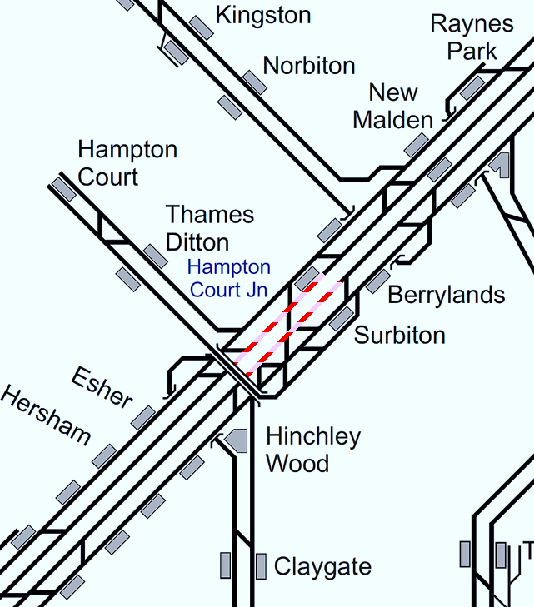
Plan 1.2 Surbiton - Hampton Court Junction
Bournemouth Main Line | Status: DMFL or UMFL blocked
Principles of Service Alteration
Trains diverted via DMSL or UMSL.
Alternative Passenger Journey
1Axx xx.23/53 follow 1Pxx xx.30/00 ex Surbiton.
Information for Signallers
Divert via DMSL or UMSL. 1Axx xx.23/53 Waterloo to Alton should follow 1Pxx xx.00/30 from Surbiton if possible.
Additional Information for Station Staff
Non-stop trains will pass through Down Slow/Hampton Court platforms.
Passenger Information
N/A

Slide 5
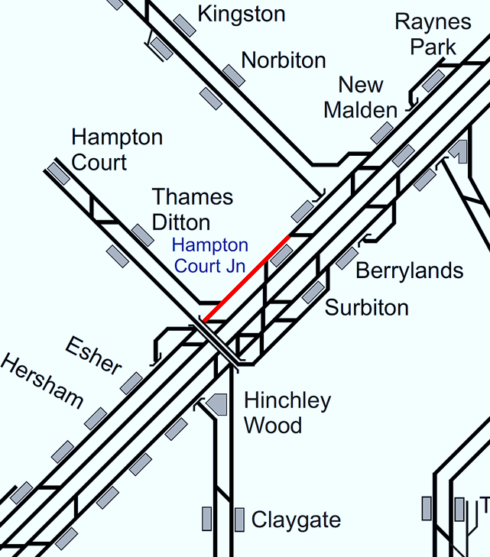
Plan 1.3 Surbiton - Hampton Court Junction
Bournemouth Main Line | Status: UMSL blocked
Principles of Service Alteration
If no access from New Line, 2Gxx Guildford (C) services diverted via Woking (call for crew purposes). AM Peak 2Jxx Hampton Court services cancelled. After 1000 2Jxx Hampton Ct - Waterloo services run over reversible line to Surbiton. Shuttle service will be required during PM peak to avoid crossing moves.
Alternative Passenger Journey
SWR Bus Replacement Effingham Junction to Surbiton. DO NOT RUN AM Peak shuttle.
Information for Signallers
Between 0600 and 1000 2Jxx Hampton Court services Cancelled. 2J xx Hampton Ct - Waterloo services run over reversible line to Surbiton. Shuttle service will be required during PM peak to avoid crossing moves. 2Gxx up services will be diverted via Epsom if already departed GLD or via Woking. DO NOT RUN AM Shuttle (overcrowding Surbiton station).
Additional Information for Station Staff
Bus replacement service from Effingham Junction to Surbiton.
Passenger Information
Passengers from Hinchley Wood, Claygate, Oxshot, Cobham and Stoke D’Abernon and Effingham Junction, Travel by Bus Replacement Service. K3 bus from Hinchley Wood to Surbiton (12 minutes) and Claygate to Surbiton (21 minutes) every 15 minutes. K2 bus Surbiton to Berrylands. (Every 10-12 minutes) journey time 6 minutes.

Slide 6
Hampton Court Junction
Plan 2 | Hampton Court Junction - Weybridge Bournemouth Main Line
2.1 | DMFL blocked
2.2 | UMFL blocked | ✔
2.3 | DMSL blocked
2.4 | UMSL blocked
2.5 | DMSL & DMFL blocked or UMSL & UMFL blocked | ✔

Slide 7
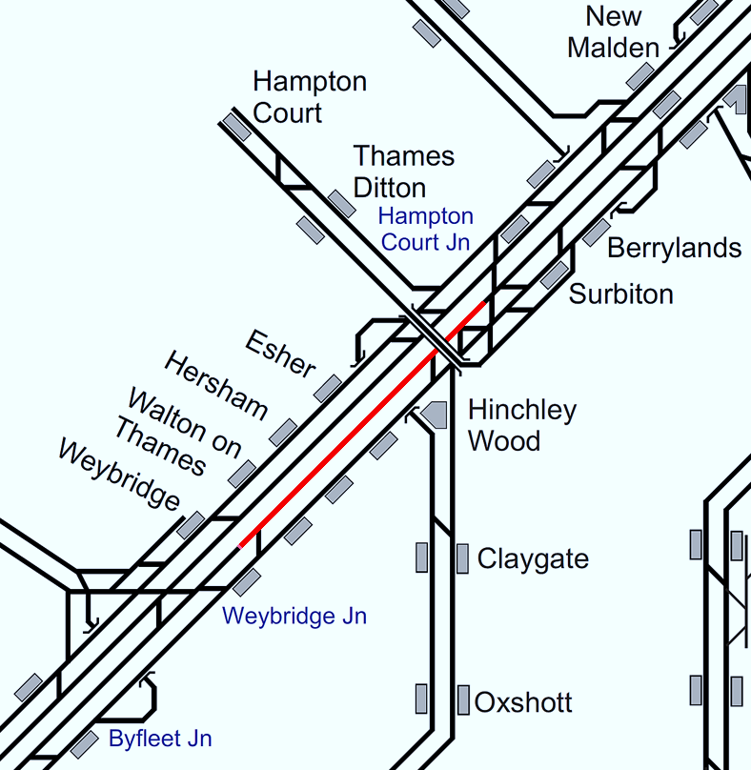

Plan 2.1 Hampton Court Junction - Weybridge
Bournemouth Main Line | Status: DMFL blocked
Principles of Service Alteration
Trains diverted via DMSL.
Alternative Passenger Journey
2Fxx Waterloo to Woking run fast Surbiton to Weybridge.
Information for Signallers
See Principles of Service Alteration.
Additional Information for Station Staff
Non-stop trains will pass through Down Slow/Hampton Court platforms. 2Fxx xx.20/50 Waterloo to Woking not to call Esher, Hersham, Walton on Thames, passengers to circulate via Surbiton and Weybridge.
Passenger Information
Local buses. Surbiton to/from Weybridge Bus 515 (Hourly) Esher 30 minutes, Hersham 32 minutes, Walton on Thames 42 minutes, Weybridge 50 minutes.

Slide 8
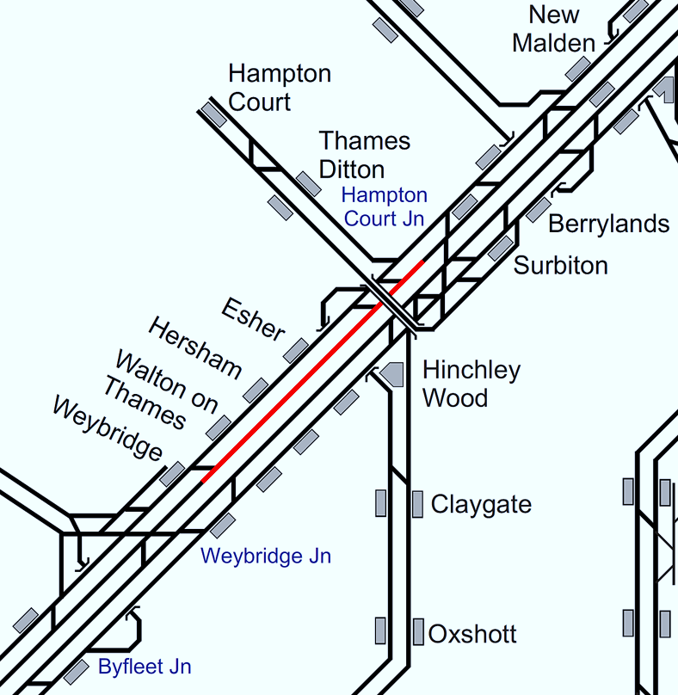
Plan 2.2 Hampton Court Junction - Weybridge
Bournemouth Main Line | Status: UMFL blocked
Principles of Service Alteration
Trains diverted via UMSL.
Alternative Passenger Journey
2Fxx xx.03/33 will not to call, Walton on Thames Hersham and Esher follow 2Pxx from Byfleet, passengers to circulate via Surbiton. 1Axx xx.14/44 follow 1Wxx xx20 Weymouth or 1Bxx xx.41 Poole ex Byfleet.
Information for Signallers
Trains diverted via UMSL, 2Fxx xx.03/33 will not call Walton on Thames, Hersham or Esher. 1Axx xx.14/44 Alton follow 1Wxx xx20 Weymouth/1Bxx xx.41 Poole from Byfleet.
Additional Information for Station Staff
2Fxx xx03/33 will not call Walton on Thames, Hersham or Esher, passengers to circulate via Surbiton and Weybridge.
Passenger Information
Local buses. Surbiton to/from Weybridge Bus 515 (Hourly) Esher 30 minutes, Hersham 32 minutes, Walton on Thames 42 minutes, Weybridge 50 minutes.

Slide 9
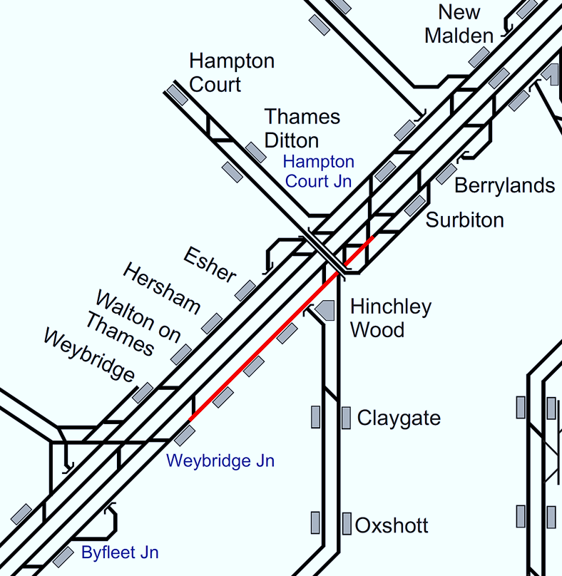
Plan 2.3 Hampton Court Junction - Weybridge
Bournemouth Main Line | Status: DMSL blocked
Principles of Service Alteration
Trains diverted via DMFL.
Alternative Passenger Journey
Passengers on 2Fxx xx.20/50 Waterloo - Woking for Esher, Hersham or Walton circulate via Weybridge. Follow 1Pxx Surbiton 2Lxx xx.42/12 follow 2Pxx xx.45/15 from Surbiton.
Information for Signallers
Trains diverted via DMFL, 2Fxx xx.20/50 Waterloo to Woking not to call Esher, Hersham, Walton on Thames and follows 1Pxx xx.00/30 from Surbiton. 2Lxx xx.42/12 (not to call Walton on Thames) follow 2Pxx xx.45/15 from Surbiton.
Additional Information for Station Staff
2Fxx xx.20/50 Waterloo to Woking not to call Esher, Hersham, Walton on Thames, passengers to circulate via Surbiton and Weybridge.
Passenger Information
Local buses. Surbiton to/from Weybridge Bus 515 (Hourly) Esher 30 minutes, Hersham 32 minutes, Walton on Thames 42 minutes, Weybridge 50 minutes.

Slide 10
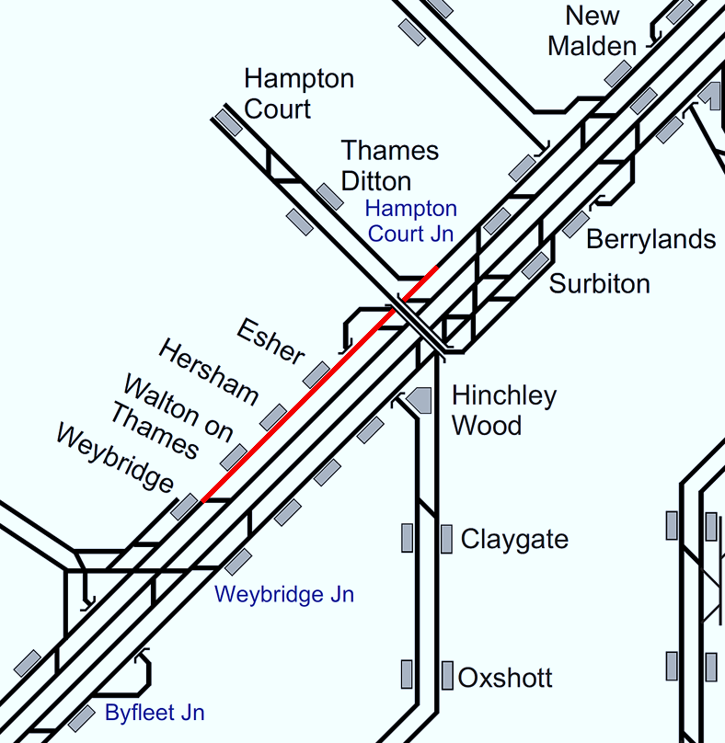
Plan 2.4 Hampton Court Junction - Weybridge
Bournemouth Main Line | Status: UMSL blocked
Principles of Service Alteration
Trains diverted via UMFL.
Alternative Passenger Journey
2Fxx xx.03/33 passengers on for Walton, Hersham or Esher circulate via Surbiton.
Information for Signallers
Trains diverted on UMFL 2Fxx xx.03/33 not to call Walton on Thames, Hersham or Esher, 2Lxx xx.34/54 not to call Walton on Thames.
Additional Information for Station Staff
2Fxx xx.03/33 not to call Walton on Thames, Hersham or Esher. 2Lxx xx.34/54 not to call Walton on Thames. Passengers to circulate via Surbiton and Weybridge.
Passenger Information
Local buses. Surbiton to/from Weybridge Bus 515 (Hourly) Esher 30 minutes, Hersham 32 minutes, Walton on Thames 42 minutes, Weybridge 50 minutes.

Slide 11
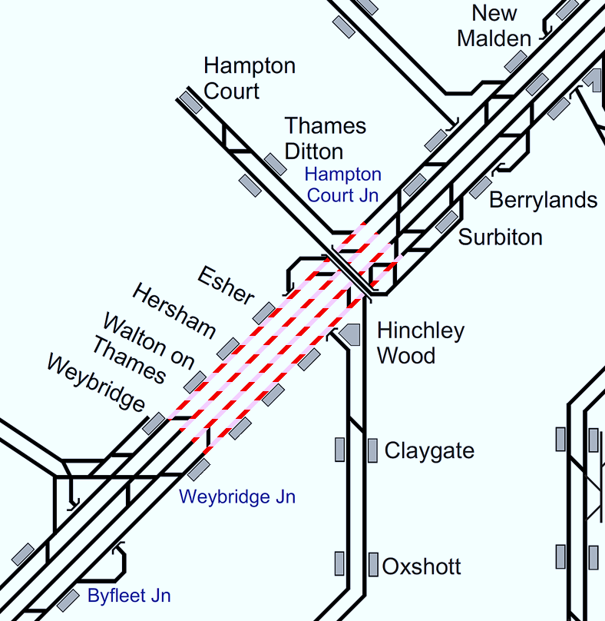
Plan 2.5 Hampton Court Junction - Weybridge
Bournemouth Main Line | Status: DMSL & DMFL blocked or Status: UMSL & UMFL blocked
Principles of Service Alteration
1Lxx xx.20/50 Waterloo - Salisbury/Exeter. 1Lxx xx.20/45 Exeter/Salisbury – Waterloo. Terminate/start Basingstoke/Woking (consider Reading if 5 coaches or less) 1Wxx xx.05 Waterloo – Weymouth. 1Wxx xx.20 Weymouth – Waterloo. Start/terminate Basingstoke 1Bxx xx.35 Waterloo – Poole. 1Bxx xx.41 Poole – Waterloo. Terminate/start Woking Portsmouth line services via (EH). 1Txx xx.09 Waterloo-Portsmouth Harbour(EH) & 1Txx xx.59 Portsmouth Harbour (EH) – Waterloo. Terminate/start Basingstoke 1Axx xx.23/53 Waterloo to Alton. 1Axx xx.14/44 Alton to Waterloo. Divert via Chertsey (Check Crew route knowledge) |  | 2Lxx xx.12/42 Waterloo – Basingstoke. 2Lxx xx.24/54 Basingstoke – Waterloo. Terminate at Woking 1Pxx xx.30 Waterloo - Portsmouth and 1Pxx xx.45 Portsmouth to Waterloo divert via Cobham. 2Pxx xx.45 Waterloo – Portsmouth & Southsea xx.24 Portsmouth & Southsea– Waterloo divert via Cobham 1Pxx xx.00 Waterloo – Haslemere / xx.02 Haslemere – Waterloo Cancelled – Use stock to run a Woking – Guildford shuttle. 1Pxx/2Pxx xx.00/xx.15 ex Waterloo and Up Peak additional services to be cancelled and stock to rebalance. 1Gxx to run as booked 2Gxx xx.03/33 Guildford (C) services run as booked 2Dxx xx 54 Waterloo – Guildford & xx.45 Guildford to Waterloo Consider terminating at Effingham Jn if crew in and out at Guildford to free up Platform 2 or 3 2Fxx Woking divert via Chertsey Call Clapham Jn, West Byfleet Woking only.
Alternative Passenger Journey
SWR bus replacement. Local buses.
Information for Signallers
See Principles of Service Alteration. Diverted 2Fxx services to run ahead of 2Cxx from Barnes
Additional Information for Station Staff
SWR Bus Replacement Fast Bus Surbiton to Woking & all stations to Weybridge. Alternative: Alton line passengers can travel via Ascot to Clapham and Waterloo. Passengers for Weybridge can travel via Staines and Virginia Water.
Passenger Information
Local buses. Surbiton to/from Weybridge Bus 515 (Hourly) Esher 30 minutes, Hersham 32 minutes, Walton on Thames 42 minutes, Weybridge 50 minutes.

Slide 12
Weybridge
Plan 3 | Weybridge - Woking Bournemouth Main Line
3.1 | DMFL blocked
3.2 | UMFL blocked
3.3 | DMSL blocked
3.4 | UMSL blocked
3.5 | DMSL & DMFL blocked or UMSL & UMFL blocked

Slide 13
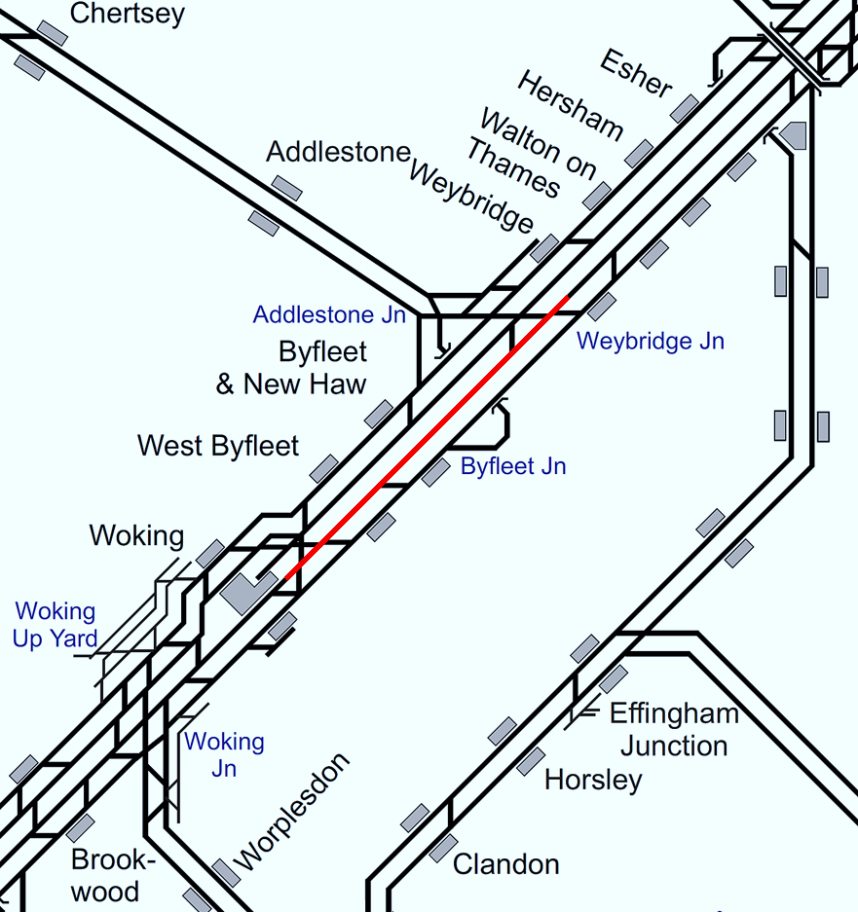
Plan 3.1 Weybridge - Woking
Bournemouth Main Line | Status: DMFL blocked
Principles of Service Alteration
Trains diverted via DMSL. 2Fxx run fast from Weybridge to Woking.
Alternative Passenger Journey
Not required.
Information for Signallers
See Principals of Service Alteration.
Additional Information for Station Staff
Passengers circulate via Weybridge or Woking.
Passenger Information
Passengers for Byfleet & New Haw or West Byfleet circulate via Woking. Passengers from Byfleet & New Haw or West Byfleet for Woking travel to Weybridge and circulate. Local buses. Weybridge to Byfleet & New Haw (19 minutes) to West Byfleet (27 minutes) and Woking (41 minutes) Bus 436 (every hour). Addlestone to Byfleet & New Haw (9 minutes) to West Byfleet (22 minutes) and Woking (39 minutes) Bus 456 (every hour).

Slide 14
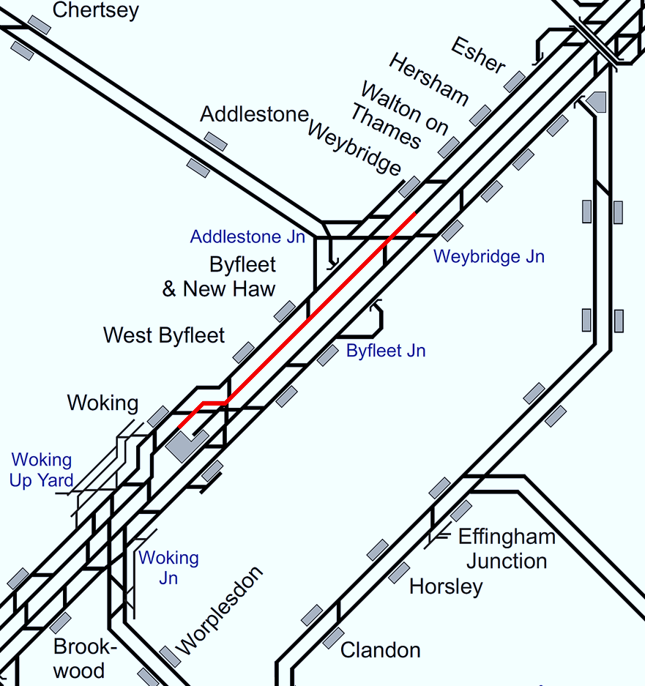
Plan 3.2 Weybridge - Woking
Bournemouth Main Line | Status: UMFL blocked
Principles of Service Alteration
Trains diverted via UMSL. 2Fxx run fast from Woking to Weybridge.
Alternative Passenger Journey
Not required.
Information for Signallers
See Principals of Service Alteration.
Additional Information for Station Staff
Passengers circulate via Weybridge or Woking.
Passenger Information
Passengers for Byfleet & New Haw or West Byfleet circulate via Weybridge. Passengers from Byfleet & New Haw or West Byfleet for Weybridge travel to Woking and circulate. Local buses. Woking to Byfleet & New Haw (34 minutes) to West Byfleet (22 minutes) and Weybridge (48 minutes) Bus 436 (every hour). Woking to West Byfleet (21 minutes) to New Haw (34 minutes) to Addlestone (42 minutes) to Chertsey (52 minutes) Bus 456 (every hour).

Slide 15
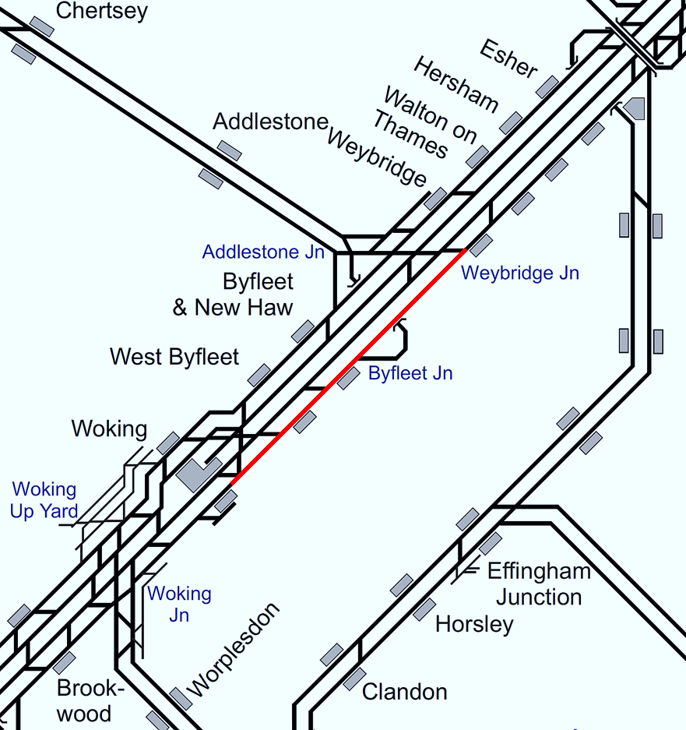
Plan 3.3 Weybridge - Woking
Bournemouth Main Line | Status: DMSL blocked
Principles of Service Alteration
Trains diverted via DMFL. 1Txx precede 2Fxx ex Weybridge. 2Fxx do not call Byfleet and New Haw. Passengers for Byfleet & New Haw circulate via West Byfleet.
Alternative Passenger Journey
Not required.
Information for Signallers
See Principals of Service Alteration.
Additional Information for Station Staff
N/A.
Passenger Information
Passengers for Byfleet & New Haw circulate via West Byfleet. Passengers from Byfleet & New Haw for Woking travel to Weybridge and circulate. Local buses. Weybridge to Byfleet & New Haw (19 minutes) to West Byfleet (27 minutes) and Woking (41 minutes) Bus 436 (every hour). Addlestone to Byfleet & New Haw (9 minutes) to West Byfleet (22 minutes) and Woking (39 minutes) Bus 456 (every hour).

Slide 16

Plan 3.4 Weybridge - Woking
Bournemouth Main Line | Status: UMSL blocked
Principles of Service Alteration
Trains diverted via UMFL. 2Fxx Woking to Waterloo runs fast to Weybridge. 1Axx Alton to Waterloo Not to call West Byfleet. Passengers for West Byfleet, Byfleet & New Haw circulate via Weybridge.
Alternative Passenger Journey
Passengers to circulate.
Information for Signallers
See Principals of Service Alteration.
Additional Information for Station Staff
N/A.
Passenger Information
Passengers for Byfleet & New Haw or West Byfleet circulate via Weybridge. Passengers from Byfleet & New Haw or West Byfleet for Weybridge travel to Woking and circulate. Local buses. Woking to Byfleet & New Haw (34 minutes) to West Byfleet (22 minutes) and Weybridge (48 minutes) Bus 436 (every hour). Woking to West Byfleet (21 minutes) to New Haw (34 minutes) to Addlestone (42 minutes) to Chertsey (52 minutes) Bus 456 (every hour).

Slide 17
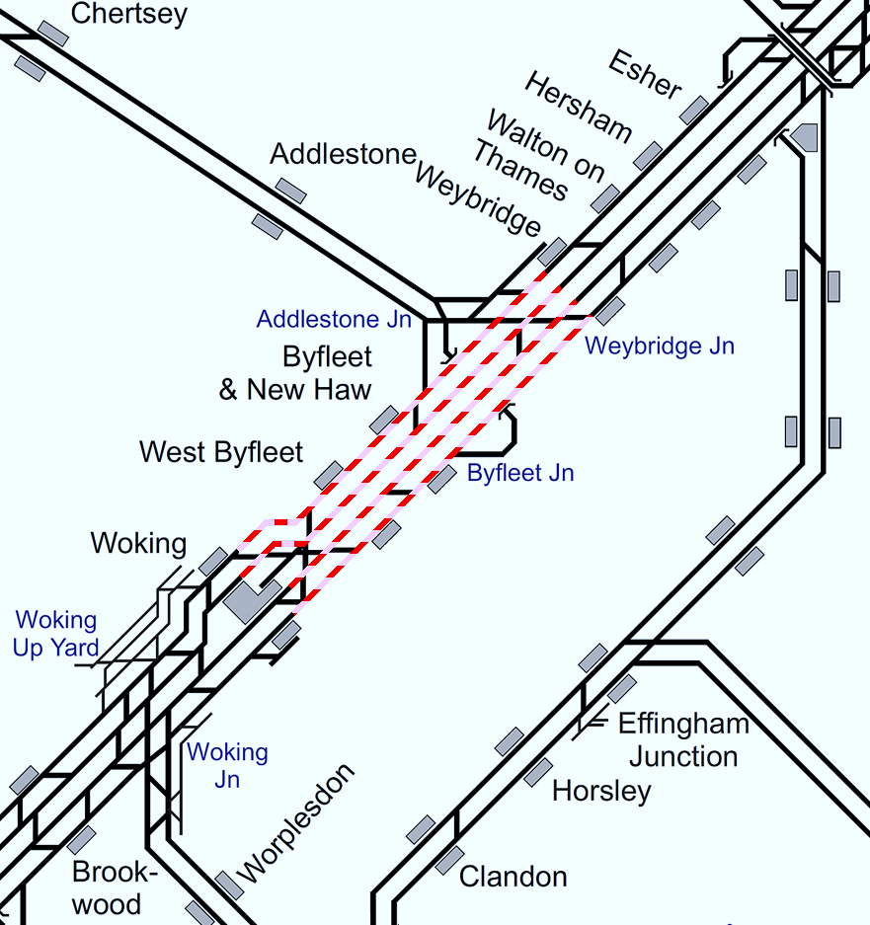
Plan 3.5 Weybridge - Woking
Bournemouth Main Line | Status: DMSL & DMFL blocked or Status: UMSL & UMFL blocked
Principles of Service Alteration
WoE services terminate/start Basingstoke 1Lxx Waterloo – Exeter and return. Divert to Reading if BV crew available 1Lxx Waterloo—Salisbury (Peak Only). Weymouth line 1Wxx xx.05 Waterloo - Weymouth. 1Wxx xx.20 Weymouth - Waterloo. Start/terminate Woking call all stations Basingstoke to Woking and vv 1Bxx xx.35 Waterloo - Poole 1Bxx xx.41 Poole - Waterloo. Start/Terminate at Basingstoke Portsmouth line services via (EH). 1Txx xx.09 Waterloo - Portsmouth Harbour (EH). 1Txx xx.51 Portsmouth Harbour (EH) - Waterloo. Terminate/Start Basingstoke Alton Services 1Axx xx.15/44 Alton to Waterloo run hourly and start/terminate at Woking. Remaining stock ECS to Farnham CS Alton line passengers may also travel via Ascot. Basingstoke service 2Lxx xx.12/42 Waterloo - Basingstoke. 2Lxx xx.24/54 Basingstoke - Waterloo. Cancelled throughout. Stock to berth at Basingstoke/Clapham Yard |  | Portsmouth line services run via Cobham. 1Pxx xx.30/2Pxx xx.45 Waterloo – Portsmouth and 1Pxx xx.45/2Pxx xx.24 Portsmouth to Waterloo divert via Cobham 1Pxx xx.00 Waterloo - Haslemere/ Portsmouth (peak) cancelled throughout 1Pxx xx.02 Haslemere – Waterloo cancelled throughout 2Pxx xx.15 Waterloo – Portsmouth & return (Peak hour) Cancelled. Stock to balance Shuttle service - Guildford – Woking. 2Fxx Waterloo -Woking Stopping service terminate Weybridge and shunt via branch. Some ad hoc termination/starts Basingstoke, Woking or Guildford, according to crewing. Passengers may travel to London via Reading using XC and GWR. Consider Salisbury starter diverting to Reading if Crew knowledge allows.
Alternative Passenger Journey
SWR Bus replacement. Ticket acceptance Southern/GTR & GWR.
Information for Signallers
See Principals of Service Alteration. Trapped Trains possibly Divert via Cobham. Hold trains in Stations where available.
Additional Information for Station Staff
Ticket acceptance GWR to/From Basingstoke via Reading to Paddington. GWR and Southern Guildford to Dorking and Southampton to Clapham Junction. SWR Bus Replacement Woking to Weybridge Fast and Stopping.
Passenger Information
Local buses. Woking to Addlestone 456 hourly, West Byfleet 20 minutes New Haw 37 minutes and Addlestone 44 minutes. Weybridge to West Byfleet (35 minutes), Byfleet & New Haw (19 minutes) Woking (43 minutes) (every 30 minutes) 436 Bus.

Slide 18
Woking Junction
Plan 4 | Woking Junction - Pirbright Junction Bournemouth Main Line
4.1 | DMFL or UMFL blocked
4.2 | DMSL or UMSL blocked
4.3 | All lines blocked
4.4 | Both lines blocked (in the same direction)

Slide 19
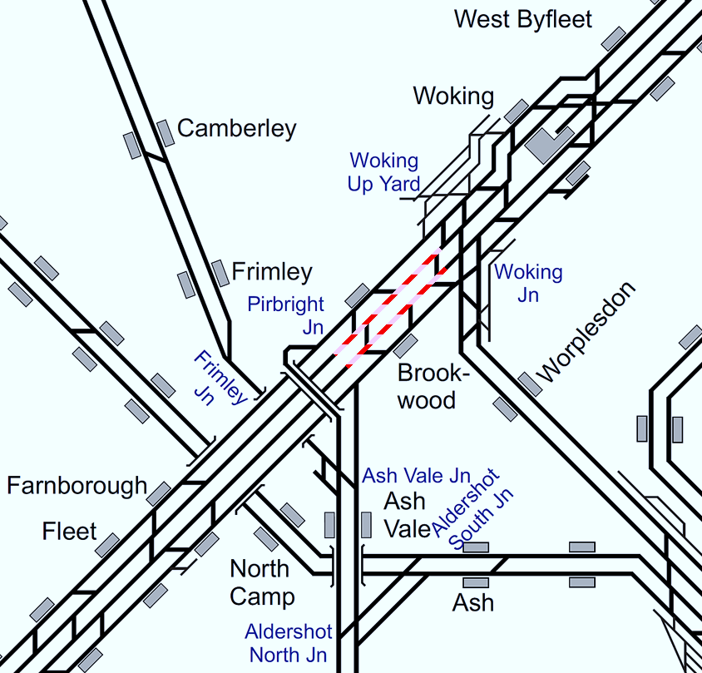
Plan 4.1 Woking Junction - Pirbright Junction
Bournemouth Main Line | Status: DMFL or UMFL blocked
Principles of Service Alteration
Trains diverted via Slow lines. Consider withdrawing Brookwood stop.
Alternative Passenger Journey
Not required.
Information for Signallers
See Principals of Service Alteration.
Additional Information for Station Staff
If Brookwood Stop withdrawn passengers to Circulate.
Passenger Information
N/A

Slide 20

Plan 4.2 Woking Junction - Pirbright Junction
Bournemouth Main Line | Status: DMSL or UMSL blocked
Principles of Service Alteration
Trains diverted via Fast lines. 1Axx Alton service divert via Guildford in blocked direction. Passengers from/to Brookwood not served either circulate via adjacent stations, or by bus service.
Alternative Passenger Journey
SWR Bus Woking – Brookwood - Farnborough. Passengers circulate.
Information for Signallers
See Principles of Service Alteration.
Additional Information for Station Staff
SWR Bus Woking- Brookwood- Farnborough Passengers Circulate.
Passenger Information
N/A

Slide 21
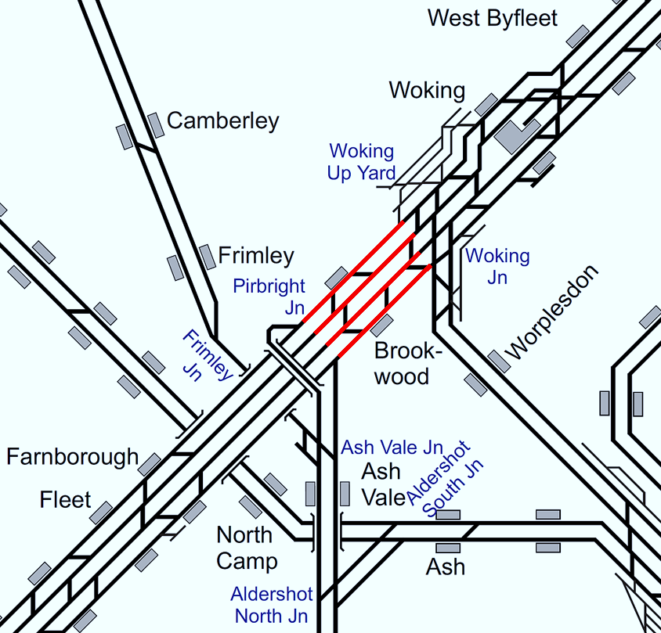
Plan 4.3 Woking Junction - Pirbright Junction
Bournemouth Main Line | Status: All lines blocked
Principles of Service Alteration
WoE services terminate/start Basingstoke. 1Axx Waterloo - Alton services diverted via Guildford call all stations vice 2Jxx. 1Txx xx.09 Waterloo - Portsmouth Harbour (EH) & return services start/terminate Basingstoke. 1Bxx xx.35 Waterloo - Poole & return services Divert via Havant. 1Wxx xx.05 Waterloo - Weymouth & return services start/terminate Southampton. 2Lxx xx.12/42 Waterloo - Basingstoke stopping services shuttle Basingstoke to Farnborough. SWR bus services between railheads. Fast buses between Woking & Basingstoke. Possibility of bus service Alton - Winchester (to relieve Woking - Basingstoke buses). Capacity at Basingstoke for terminating trains may be a problem. Consider running 1Lxx Salisbury to Waterloo to Reading. 2Jxx Farnham to Guildford and return Cancelled (withdrawn to provide Pilot drivers for 1Axx via Guildford) SSO Wanborough and Ash. Note: If a 1Lxx service is trapped London side of the block then terminate at Woking and run ECS to point of obstruction or to return to London if crew willing. [The above was added in response to feedback to Plan 5.3 (03/03/21)]
Alternative Passenger Journey
Ticket acceptance Southern/GTR & GWR SWR Bus Replacement
Information for Signallers
WoE services terminate/start Basingstoke. 1Axx Waterloo - Alton services diverted via Guildford. 1Txx xx.09 Waterloo - Portsmouth Harbour (EH) & return services start/terminate Basingstoke. 1Bxx xx.35 Waterloo - Poole & return services Divert via Havant. 1Wxx xx05 Waterloo - Weymouth & return services start/terminate Southampton. 2Lxx xx.12/42 Waterloo - Basingstoke stopping services shuttle Basingstoke to Farnborough. 2Jxx Farnham to Guildford and return Cancelled
Additional Information for Station Staff
SWR Bus replacement Woking to Farnborough (if Farnborough -Basingstoke shuttle implemented) if not Woking to Basingstoke Fast Bus and Stopping bus. Ticket acceptance GWR Farnborough North to Guildford & Basingstoke to Paddington via Reading GTR/Southern Southampton to Havant and Clapham Junction 2Jxx Farnham to Guildford and return cancelled. 1Axx Alton services diverted via Guildford SSO Wanborough and Ash
Passenger Information
N/A

Slide 22

Plan 4.4 Woking Junction - Pirbright Junction
Bournemouth Main Line | Status: Both lines blocked (in the same direction)
Principles of Service Alteration
WoE services terminate/start Basingstoke. 1Axx Waterloo - Alton services diverted via Guildford. In blocked direction 1Txx xx.09 Waterloo - Portsmouth Harbour (EH) & return services start/terminate Basingstoke. 1Bxx xx.35 Waterloo - Poolw & return Divert via Havant. In blocked direction 1Wxx xx.05 Waterloo - Weymouth & return Divert via Havant in Blocked direction 2Lxx xx.12/42 Waterloo - Basingstoke stopping services shuttle Basingstoke to Farnborough. SWR bus services between railheads. Fast buses between Woking & Basingstoke. Possibility of bus service Alton - Winchester (to relieve Woking - Basingstoke buses). Capacity at Basingstoke for terminating trains may be a problem. Consider running 1Lxx Salisbury to Waterloo to Reading. 2Jxx Farnham to Guildford and return Cancelled (withdrawn to provide Pilot drivers for 1Axx via Guildford) SSO Wanborough and Ash.
Alternative Passenger Journey
Ticket acceptance Southern/GTR & GWR SWR Bus Replacement
Information for Signallers
WoE services terminate/start Basingstoke. 1Axx Waterloo - Alton services diverted via Guildford. 1Txx xx.09 Waterloo - Portsmouth Harbour (EH) & return services start/terminate Basingstoke. 1Bxx xx.35 Waterloo - Poole & return services Divert via Havant.in blocked direction 1Wxx xx05 Waterloo - Weymouth & return services Divert via Havant in Blocked Direction. 2Lxx xx.12/42 Waterloo - Basingstoke stopping services shuttle Basingstoke to Farnborough. 2Jxx Farnham to Guildford and return may be Cancelled (to provide Pilot crew)
Additional Information for Station Staff
SWR Bus replacement Woking to Farnborough (if Farnborough -Basingstoke shuttle implemented) if not Woking to Basingstoke Fast Bus and Stopping bus. Ticket acceptance GWR Farnborough North to Guildford & Basingstoke to Paddington via Reading GTR/Southern Southampton to Havant and Clapham Junction 2Jxx Farnham to Guildford and return Might be cancelled to provide pilot drivers for 1Axx. 1Axx Alton services diverted via Guildford in Blocked direction
Passenger Information
N/A

Slide 23
Pirbright Junction
Plan 5 | Pirbright Junction - Basingstoke Bournemouth Main Line
5.1 | DMFL or UMFL blocked
5.2 | DMSL or UMSL blocked
5.3 | All lines blocked | ✔
5.4 | Both lines blocked (in same direction) | ✔

Slide 24
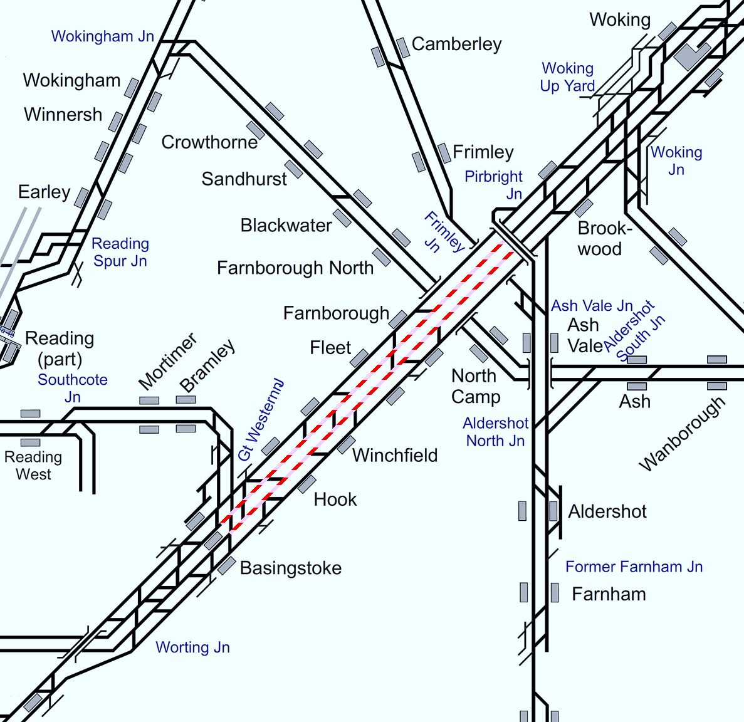
Plan 5.1 Pirbright Junction - Basingstoke
Bournemouth Main Line | Status: DMFL or UMFL blocked
Principles of Service Alteration
Trains diverted via Slow lines over shortest distance. Consideration must be given to the withdrawal of station stops in order to prevent delay to Fast trains. Passengers from stations not served either circulate via adjacent stations, or by bus service, if instituted.
Alternative Passenger Journey
SWR Bus replacement Passengers to circulate
Information for Signallers
See Principals of Service Alteration.
Additional Information for Station Staff
Passengers to circulate where possible SWR bus replacement Woking to Basingstoke all stations in Blocked direction only.
Passenger Information
N/A

Slide 25

Plan 5.2 Pirbright Junction - Basingstoke
Bournemouth Main Line | Status: DMSL or UMSL blocked
Principles of Service Alteration
Trains diverted via Fast lines over shortest distance. Consideration must be given to the withdrawal of station stops in order to prevent delay to Fast trains. Passengers from stations not served either circulate via adjacent stations, or by bus service, if instituted.
Alternative Passenger Journey
SWR Bus replacement. Passengers to circulate.
Information for Signallers
See Principals of Service Alteration.
Additional Information for Station Staff
Passengers to circulate where possible. SWR bus replacement Woking to Basingstoke all stations in Blocked direction only.
Passenger Information
N/A

Slide 26
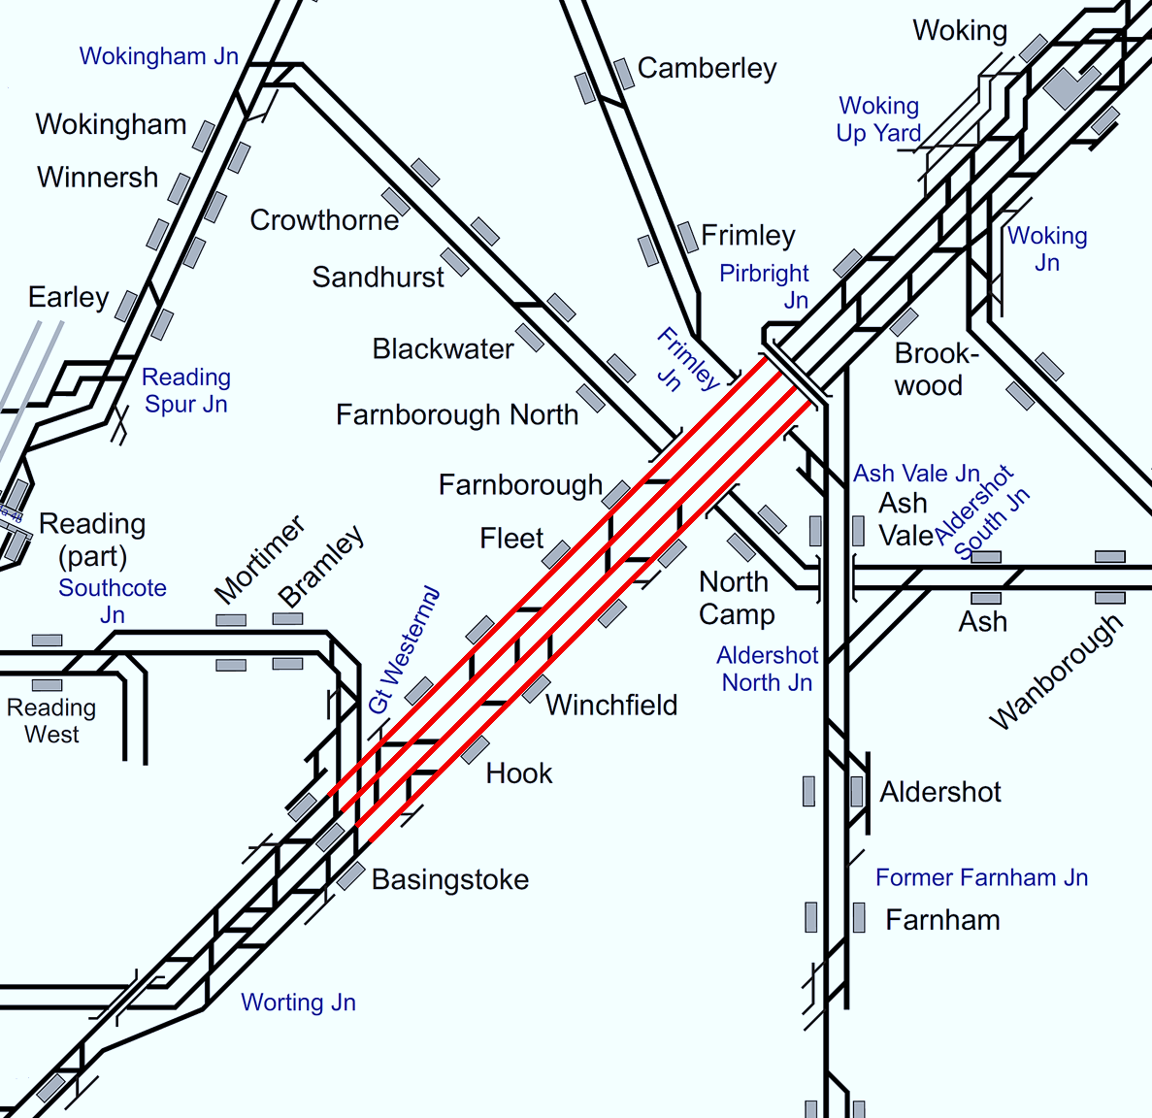
Plan 5.3 Pirbright Junction - Basingstoke
Bournemouth Main Line | Status: All lines blocked
Principles of Service Alteration
WoE services terminate/start Basingstoke. 1Txx xx.09 Waterloo - Portsmouth Harbour (EH) & return services start/terminate Basingstoke. 1Bxx xx.35 Waterloo - Poole & return services Divert via Havant. 1Wxx xx.05 Waterloo - Weymouth & return services start/terminate Basingstoke to Weymouth. 2Lxx xx.12/42 Waterloo - Basingstoke stopping services terminate/start Woking or divert to Alton. Bus services between railheads. Fast buses between Woking & Basingstoke. Possibility of bus service Alton - Winchester (to relieve Woking - Basingstoke buses). Capacity at Basingstoke for terminating trains may be a problem. Consider extending 1Lxx to Reading. Trains trapped London side of blockage Consider diversion via Havant or Terminate Woking and ECS to Clapham Yard. Note: If a 1Lxx service is trapped London side of the block then terminate at Woking and run ECS to point of obstruction or to return to London if crew willing. [The above was added in response to feedback (03/03/21)]
Alternative Passenger Journey
SWR bus replacement. Local buses. Ticket acceptance Southern/GTR and GWR.
Information for Signallers
WoE services terminate/start Basingstoke. 1Txx xx.09 Waterloo - Portsmouth Harbour (EH) & return services start/terminate Basingstoke. 1Bxx xx.35 Waterloo - Poole & return services Divert via Havant. 1Wxx xx.05 Waterloo - Weymouth & return services start/terminate Basingstoke to Weymouth. 2Lxx xx.12/42 Waterloo - Basingstoke stopping services terminate/start Woking. Trains trapped London side of blockage Consider diversion via Havant or Terminate Woking and ECS to Clapham Yard.
Additional Information for Station Staff
Ticket acceptance GWR Farnborough North to Guildford and Basingstoke via Reading to Paddington. Southern/GTR Southampton to Havant/Clapham Junction. SWR Bus replacement. Fast Buses Woking to Basingstoke. All stations Woking to Basingstoke. Fast Bus Alton to Winchester.
Passenger Information
Local buses. Basingstoke to Hook and Alton Bus 13 Hourly Hook 18 minutes Alton 42 minutes Fleet to Aldershot infrequent journey 45 minutes. Farnborough to Fleet Bus 10 Hourly 15 minutes Farnborough to Aldershot bus Gold 1 Farnborough to Farnborough North (5 mins) bus 41 Infrequent ( Walk 10-12 Minutes) Brookwood to Woking Buses 28,48,91 Infrequent 30 minutes.

Slide 27
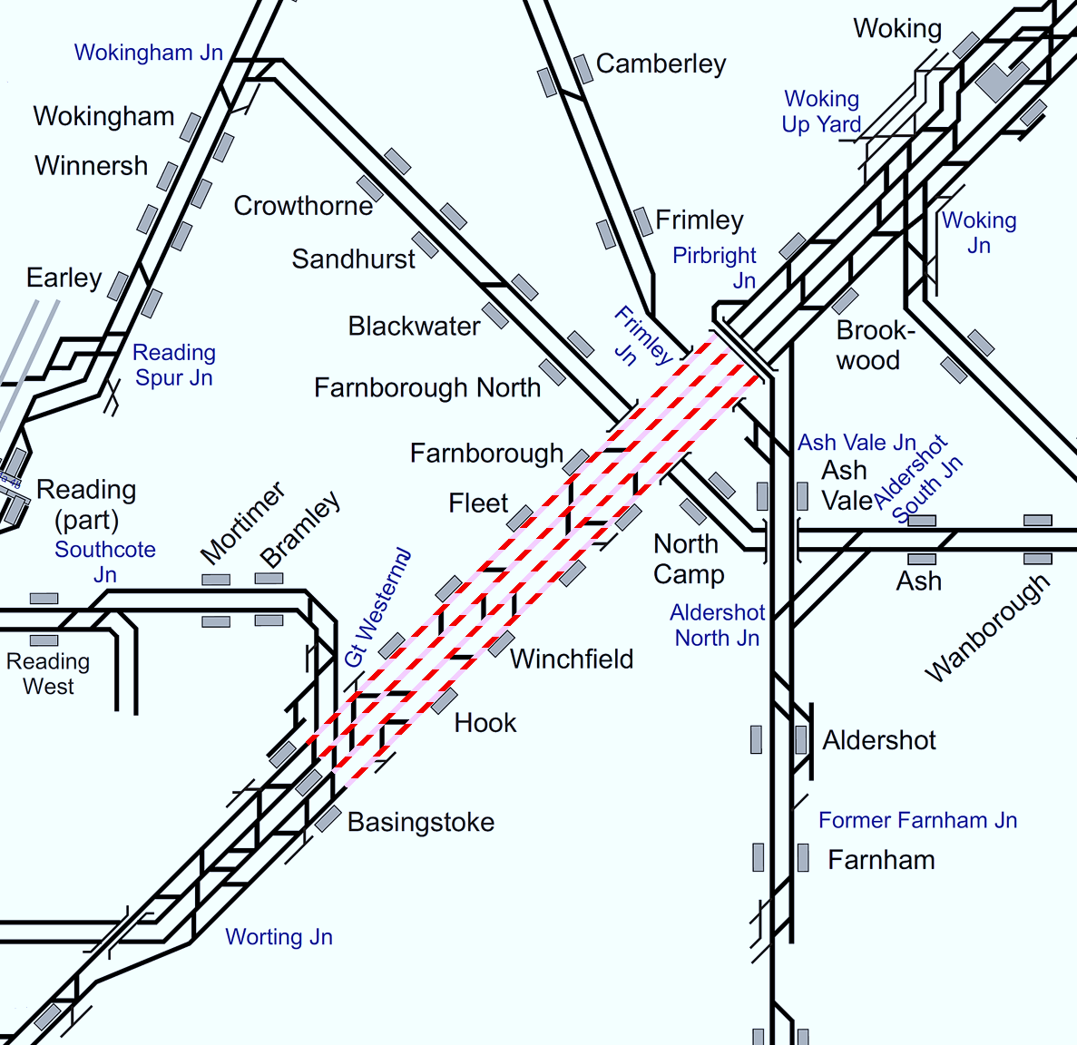
Plan 5.4 Pirbright Junction - Basingstoke
Bournemouth Main Line | Status: Both lines blocked (in the same direction)
Principles of Service Alteration
WoE services terminate/start Basingstoke. 1Txx xx.09 Waterloo - Portsmouth Harbour (EH) & return services start/terminate Basingstoke. 1Bxx xx.35 Waterloo - Poole & return Divert via Havant in blocked direction. 1Wxx xx.05 Waterloo - Weymouth & return Divert via Havant in Blocked direction 2Lxx xx.12/42 Waterloo - Basingstoke stopping services terminate/start Woking or divert to Alton. Bus services between railheads. Fast buses between Woking & Basingstoke. Possibility of bus service Alton - Winchester (to relieve Woking - Basingstoke buses). Capacity at Basingstoke for terminating trains may be a problem. Consider extending 1Lxx to Reading Trains trapped London side of blockage Consider diversion via Havant or Terminate Woking and ECS to Clapham Yard.
Alternative Passenger Journey
SWR bus replacement. Local buses. Ticket acceptance Southern/GTR and GWR.
Information for Signallers
WoE services terminate/start Basingstoke. 1Txx xx.09 Waterloo - Portsmouth Harbour (EH) & return services start/terminate Basingstoke. 1Bxx xx.35 Waterloo - Poole & return Divert via Havant in blocked direction. 1Wxx xx.05 Waterloo - Weymouth & return Divert via Havant in Blocked direction 2Lxx xx.12/42 Waterloo - Basingstoke stopping services terminate/start Woking or divert to Alton Trains trapped London side of blockage Consider diversion via Havant or Terminate Woking and ECS to Clapham Yard.
Additional Information for Station Staff
Ticket acceptance GWR Farnborough North to Guildford and Basingstoke via Reading to Paddington. Southern/GTR Southampton to Havant/Clapham Junction. SWR Bus replacement Fast Buses Woking to Basingstoke All stations Woking to Basingstoke Fast Bus Alton to Winchester.
Passenger Information
Local buses. Basingstoke to Hook and Alton Bus 13 Hourly Hook 18 minutes Alton 42 minutes Fleet to Aldershot infrequent journey 45 minutes. Farnborough to Fleet Bus 10 Hourly 15 minutes Farnborough to Aldershot bus Gold 1 Farnborough to Farnborough North (5 mins) bus 41 Infrequent (Walk 10-12 Minutes) Brookwood to Woking Buses 28,48,91 Infrequent 30 minutes.

Slide 28
Plan 5a.1 Basingstoke Station blocked
Bournemouth Main Line | Status: All lines blocked
Principles of Service Alteration
WoE services terminate/start Salisbury (consider running Up Exeter service to Southampton if possible). Run hourly shuttle Salisbury to Andover calling at Grateley 1Txx xx.09 Waterloo - Portsmouth Harbour (EH) & return services Start/Terminate at Winchester 1Bxx xx.35 Waterloo - Poole & return services Divert via Havant. 1Wxx xx.05 Waterloo - Weymouth & return services start/terminate Southampton 2Lxx xx.12 Waterloo – Basingstoke stopping service Terminate and start back at Farnborough (Crew to taxi to and from Basingstoke. Down driver to perform shunt at Farnborough 2Lxx xx.42 Waterloo - Basingstoke stopping services terminate/start Woking or divert to Alton. CrossCountry - 1Oxx/1Mxx divert via Guildford and Havant (Check crew route knowledge) GWR - 2Jxx Reading to Basingstoke services Cancelled throughout Freight services to be held off route. TRCs must put block on Freight with neighbouring Routes Note Crew considerations, especially at start up and end of service as WA/BV/WH crew have no route knowledge via diversionary route via Havant and Netley. At start up please refer to Basingstoke Start-Up Plan (Link here)
Alternative Passenger Journey
SWR bus replacement. (Farnborough to Basingstoke, Andover to Basingstoke and Winchester to Basingstoke). Consider buses Alton to Winchester. WoE customers to travel via GWR or Southampton if 1Lxx divert to/from Southampton No trains to serve Micheldever. Taxi/Bus to replace Local buses. Ticket acceptance Southern/GTR and GWR.
Information for Signallers
As per principles of train service alterations
Additional Information for Station Staff
Ticket acceptance GWR Farnborough North to Guildford and Basingstoke via Reading to Paddington. Southern/GTR Southampton to Havant/Clapham Junction. Salisbury to Paddington via Westbury or Southampton for 1Bxx to Waterloo SWR Bus replacement. Buses to run Andover to Basingstoke (fast and all stations), Farnborough to Basingstoke and Winchester to Basingstoke. Taxi shuttle for Micheldever Fast Bus Alton to Winchester.
Passenger Information
Local buses. Basingstoke to Hook and Alton Bus 13 Hourly Hook 18 minutes Alton 42 minutes Fleet to Aldershot infrequent journey 45 minutes. Farnborough to Fleet Bus 10 Hourly 15 minutes Farnborough to Aldershot bus Gold 1 Farnborough to Farnborough North (5 mins) bus 41 Infrequent ( Walk 10-12 Minutes) Brookwood to Woking Buses 28,48,91 Infrequent 30 minutes.

Slide 29
Basingstoke
Plan 6 | Basingstoke - Micheldever Bournemouth Main Line
6.1 | Both lines blocked
6.2 | One line blocked

Slide 30
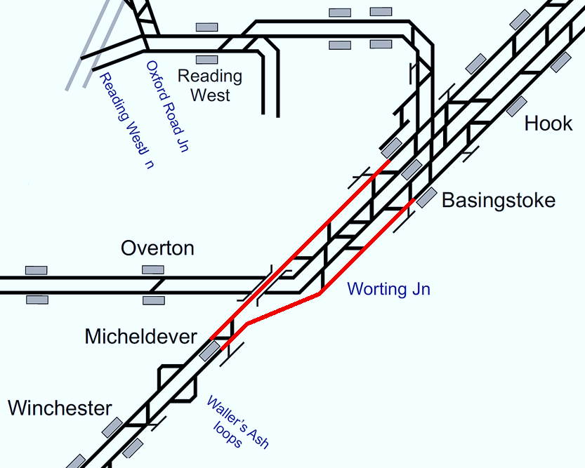

Plan 6.1 Basingstoke - Micheldever
Bournemouth Main Line | Status: Both lines blocked
Principles of Service Alteration
1Wxx xx.05 Waterloo - Weymouth & return services run between Bournemouth and Weymouth only 1Bxx xx.35 Waterloo - Poole & return services Divert via Havant. 1Txx xx.09 Waterloo - Portsmouth Harbour (EH) & return services run between Winchester & Portsmouth. CrossCountry: 1Oxx (Down) & 1Mxx (Up) services divert between Basingstoke and Southampton Central via Laverstock/Chandlers Ford/Test Valley or services terminate/start at either Basingstoke/ Reading. Trains trapped London side of blockage Terminate at Basingstoke run ECS to CLY or Wimbledon Park. All Freight services diverted via Andover or Westbury. Bus service Basingstoke - Winchester. Minibus service Basingstoke - Micheldever.
Alternative Passenger Journey
SWR Bus replacement. Local bus.
Information for Signallers
See Principles of Service Alteration.
Additional Information for Station Staff
Ticket acceptance via Salisbury to Basingstoke (GWR/SWR) & Southern/GTR to Havant and Clapham Junction. SWR Bus Replacement. Bus service Basingstoke - Winchester. Winchester -Micheldever - Basingstoke (mini bus).
Passenger Information
Local buses. Micheldever Station to Overton station 80M 4 buses 30 Minutes.

Slide 31
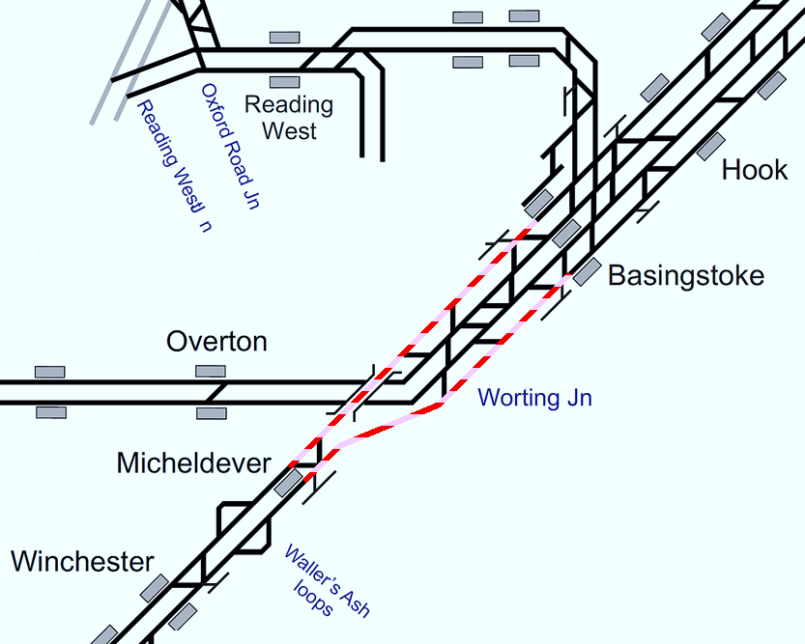
Plan 6.2 Basingstoke - Micheldever
Bournemouth Main Line | Status: One line blocked (in either direction)
Principles of Service Alteration
1Wxx xx.05 Waterloo - Weymouth & return services Divert via Havant in blocked direction 1Bxx xx.35 Waterloo - Poole & return services Divert via Havant in Blocked direction 1Txx xx.09 Waterloo - Portsmouth Harbour (EH) & return services run between Winchester & Portsmouth. CrossCountry: 1Oxx (Down) & 1Mxx (Up) services divert between Basingstoke and Southampton Central via Laverstock/Chandlers Ford/Test Valley or services terminate/start at either Basingstoke/ Reading. All Freight services diverted via Andover or Westbury. Bus service Basingstoke - Winchester. Minibus service Basingstoke - Micheldever.
Alternative Passenger Journey
SWR Bus replacement. Local bus.
Information for Signallers
See Principles of Service Alteration.
Additional Information for Station Staff
Ticket acceptance via Salisbury to Basingstoke (GWR/SWR) & Southern/GTR to Havant and Clapham Junction. SWR Bus Replacement. Bus service Basingstoke to Winchester. Winchester - Micheldever - Basingstoke (mini bus).
Passenger Information
Local buses. Micheldever Station to Overton station 80M 4 buses 30 Minutes.

Slide 32
Micheldever
Plan 7 | Micheldever - Winchester Bournemouth Main Line
7.1 | Both lines blocked
7.2 | One line blocked

Slide 33
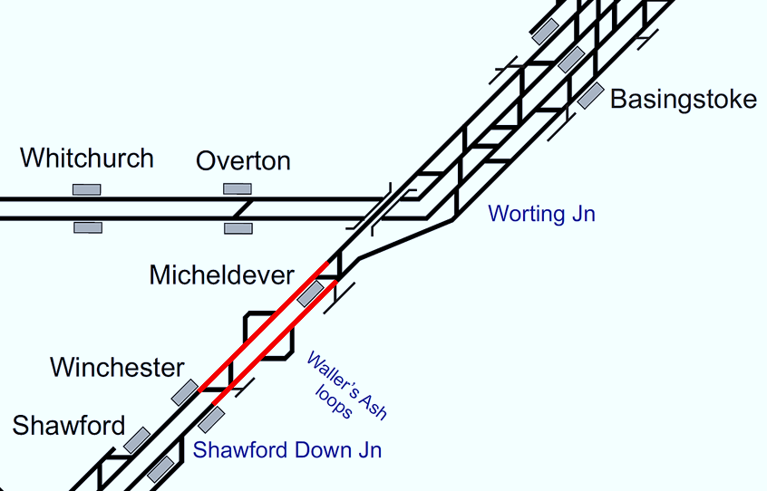
Plan 7.1 Micheldever - Winchester
Bournemouth Main Line | Status: Both lines blocked
Principles of Service Alteration
1Wxx xx.05 Waterloo - Weymouth & return services start/terminate Bournemouth to Weymouth. 1Bxx xx.35 Waterloo - Poole & return services Divert via Havant. 2Bxx xx.50 Winchester - Bournemouth & return services to run as booked if can access Baltic Sidings at Winchester. To terminate at Eastleigh if cannot use Baltic Siding 1Txx xx.09 Waterloo - Portsmouth Harbour (EH) & return services run between Winchester & Portsmouth. To terminate at Eastleigh if no access to Baltic siding CrossCountry: 1Oxx (Down) & 1Mxx (Up) services divert between Basingstoke and Southampton Central via Laverstock/Chandlers Ford/Test Valley or services terminate/start at Reading. Trains trapped London side of blockage Terminate at Basingstoke. Berth Barton Mill until blockage cleared then Run ECS to Destination. Freight services diverted via Andover or Westbury. Bus service Basingstoke - Winchester. Minibus service Basingstoke - Micheldever - Winchester.
Alternative Passenger Journey
SWR Bus replacement. Local bus.
Information for Signallers
See Principles of Service Alteration.
Additional Information for Station Staff
Ticket acceptance via Salisbury to Basingstoke (GWR/SWR) & Southern/GTR to Havant and Clapham Junction. SWR Bus Replacement. Bus service Basingstoke - Winchester. Winchester - Micheldever - Basingstoke (mini bus).
Passenger Information
Local buses. Micheldever Station to Overton station 80M 4 buses 30 Minutes.

Slide 34
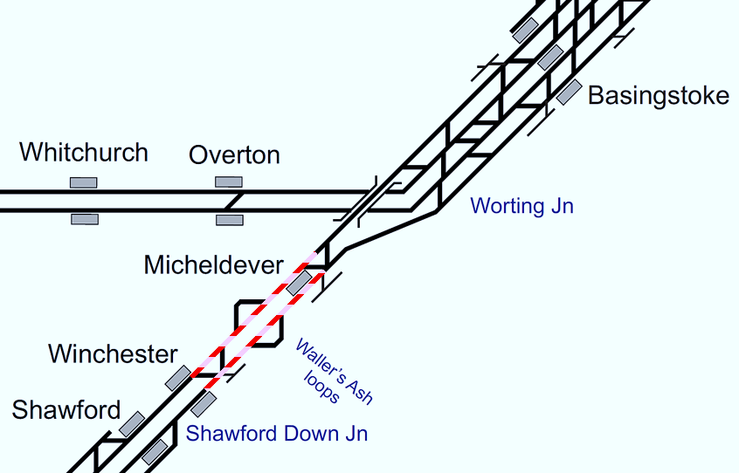
Plan 7.2 Micheldever - Winchester
Bournemouth Main Line | Status: One line blocked (in either direction)
Principles of Service Alteration
1Wxx xx.05 Waterloo - Weymouth & return services divert via Havant. 1Bxx xx.35 Waterloo - Poole & return services Via Simbids 2Bxx xx.50 Winchester - Bournemouth & return services run as booked if access available to Baltic Siding at Winchester. If no access to start at Eastleigh. 1Txx xx.09 Waterloo - Portsmouth Harbour (EH) & return services run between Winchester & Portsmouth. CrossCountry: 1Oxx (Down) & 1Mxx (Up) services divert between Basingstoke and Southampton Central via Laverstock/Chandlers Ford/Test Valley or services terminate/start at Reading. Freight services diverted via Andover or Westbury. Bus service Basingstoke - Winchester. Minibus service Basingstoke - Micheldever - Winchester.
Alternative Passenger Journey
SWR Bus replacement. Local bus.
Information for Signallers
See Principles of Service Alteration.
Additional Information for Station Staff
Ticket acceptance via Salisbury to Basingstoke (GWR/SWR) & Southern/GTR to Havant and Clapham Junction. SWR Bus Replacement. Bus service Basingstoke - Winchester. Winchester - Micheldever - Basingstoke (mini bus).
Passenger Information
Local buses. Micheldever Station to Overton station 80M 4 buses 30 Minutes.

Slide 35
Winchester
Plan 8 | Winchester - Eastleigh Bournemouth Main Line
8.1 | Both lines blocked | ✔
8.2 | One line blocked

Slide 36
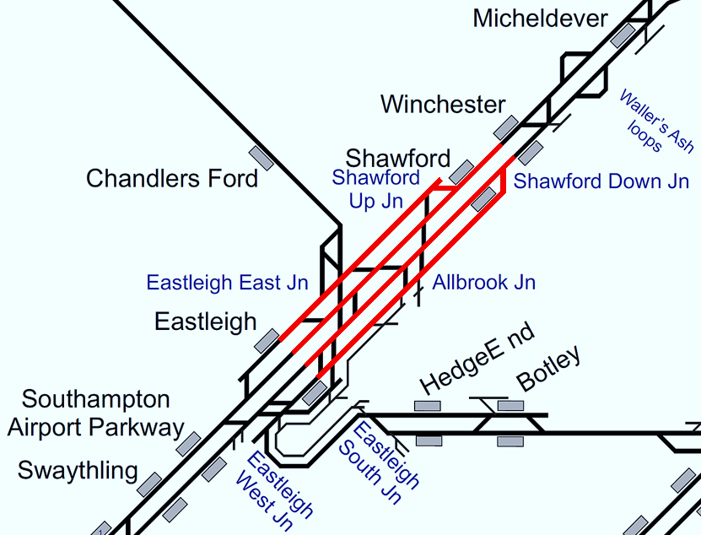
Plan 8.1 Winchester - Eastleigh
Bournemouth Main Line | Status: Both lines blocked
Principles of Service Alteration
1Wxx xx.05 Waterloo - Weymouth & return services run Bournemouth to Weymouth. 1Bxx xx.35 Waterloo - Poole & return services Divert via Havant. 2Bxx xx.50 Winchester - Bournemouth & return services run between Southampton and Bournemouth. 1Txx xx.09 Waterloo - Portsmouth Harbour (EH) & return services run between Eastleigh & Portsmouth. CrossCountry: 1Oxx (Down) & 1Mxx (Up) services divert between Basingstoke and Southampton Central via Laverstock/Chandlers Ford/Test Valley or services terminate/start at Reading. Shuttle rail service Basingstoke – Winchester if stock and crew available (Use stock ex 1Wxx) Trains trapped London side of blockage Terminate at Basingstoke or Winchester. Berth Barton Mill until blockage cleared then run ECS to Destination. Freight services diverted via Andover or Westbury. Bus service Winchester - Eastleigh/Southampton. Shawford served by minibus.
Alternative Passenger Journey
SWR Bus replacement. Local buses.
Information for Signallers
See Principles of Service Alteration.
Additional Information for Station Staff
Ticket acceptance via Salisbury to Basingstoke (GWR/SWR) & Southern/GTR to Havant and Clapham Junction. SWR Bus Replacement Winchester to Eastleigh/Southampton. Winchester - Shawford - Eastleigh (mini bus).
Passenger Information
Local buses. From Winchester to Shawford E2.3 times a day 25 minutes. Winchester to Romsey bus 66 every 30 minutes Journey 35 minutes. Winchester to Chandlers Ford and Southampton 1Bluestar every 15-20 minutes to Chandlers Ford 20 minutes, Southampton 40 minutes. Eastleigh to Winchester E1,E2 journey 40-50 minutes.

Slide 37
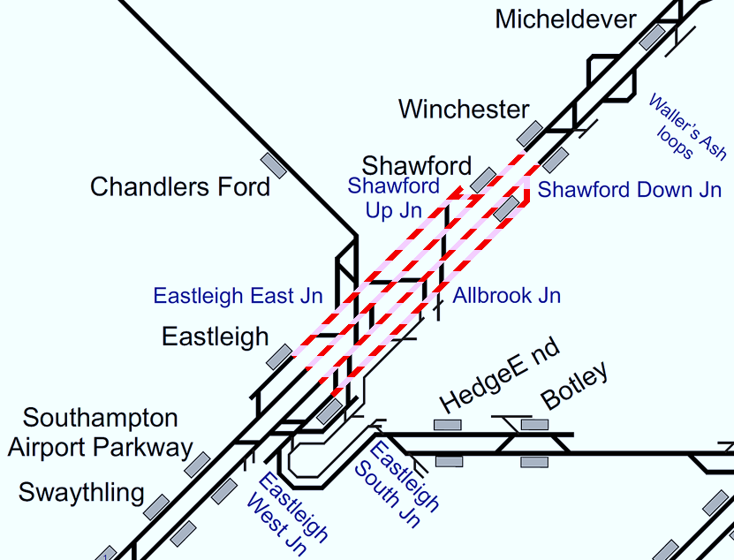
Plan 8.2 Winchester - Eastleigh
Bournemouth Main Line | Status: One line blocked (in either direction)
Principles of Service Alteration
1Wxx xx.05 Waterloo - Weymouth & return services via SIMBIDS. SSO Micheldever 1Bxx xx.35 Waterloo - Poole & return services Divert via Havant. 2Bxx xx.49 Winchester - Bournemouth & return services run between Southampton and Poole. 1Txx xx.09 Waterloo - Portsmouth Harbour (EH) & return services run between Eastleigh and Portsmouth only. CrossCountry: 1Oxx (Down) & 1Mxx (Up) services divert between Basingstoke and Southampton Central via Laverstock/Chandlers Ford/Test Valley or services terminate/start at Reading. Freight services diverted via Andover or Westbury. Shawford served by minibus.
Alternative Passenger Journey
SWR bus replacement service Local buses
Information for Signallers
See Principles of Service Alteration.
Additional Information for Station Staff
SWR Bus Replacement Winchester to Eastleigh to supplement train service. Winchester - Shawford - Eastleigh (mini bus).
Passenger Information
Local buses. From Winchester to Shawford E2.3 times a day 25 minutes. Winchester to Romsey bus 66 every 30 minutes Journey 35 minutes. Winchester to Chandlers Ford and Southampton 1Bluestar every 15-20 minutes to Chandlers Ford 20 minutes, Southampton 40 minutes. Eastleigh to Winchester E1,E2 journey 40-50 minutes.

Slide 38
Eastleigh
Plan 9 | Eastleigh - St. Denys (No access to ESJ) Bournemouth Main Line
9.1 | All lines blocked (No access to Eastleigh South Junction)

Slide 39
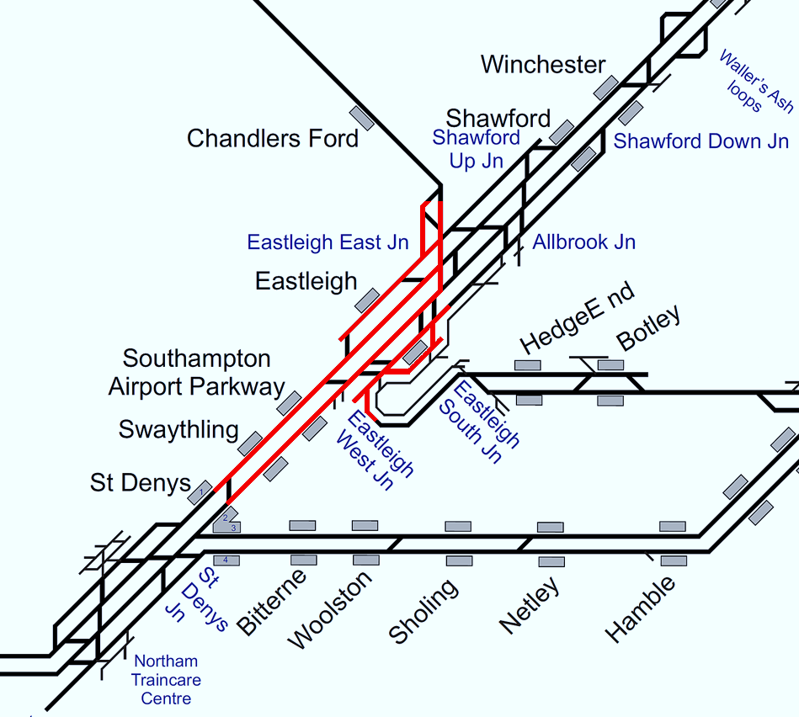
Plan 9.1 Eastleigh - St. Denys
Bournemouth Main Line | Status: All lines blocked (No access to E.S. junc)
Principles of Service Alteration
1Wxx xx.05 Waterloo - Weymouth & return services Runs Bournemouth to Weymouth. 1Bxx xx.35 Waterloo - Poole & return services Divert via Havant. 2Bxx xx.49 Winchester - Bournemouth & return services run between Southampton and Bournemouth 1Txx xx.09 Waterloo - Portsmouth Harbour (EH) & return services divert via Guildford if crew have route knowledge. . 2Rxx xx 56 Salisbury - Romsey & return services run only between Southampton & Salisbury via Test Valley. CrossCountry: 1Oxx (Down) & 1Mxx (Up) services divert between Basingstoke and Southampton Central via Laverstock/Test Valley or services terminate/start Reading. Freight services diverted via Laverstock or Westbury. Shuttle rail service Basingstoke – Winchester (if stock and crew available) Bus service Winchester - Eastleigh/Southampton. Fast bus service Basingstoke - Southampton Parkway/Southampton. SWR bus service Eastleigh - Fareham. Shawford served by minibus. Minibus Swaythling - Eastleigh - Chandlers Ford - Romsey.
Alternative Passenger Journey
Local bus / ticket acceptance Southern / SWR bus replacement
Information for Signallers
See Principles of Service Alteration.
Additional Information for Station Staff
Ticket acceptance on Southern Southampton to Havant and Clapham Junction. SWR Bus Replacement. Winchester to Eastleigh and Southampton Central (fast Bus Basingstoke to Southampton) Fareham - Botley - Eastleigh (Taxi for Hedge End).
Passenger Information
Local buses. X4,X9 Eastleigh to Hedge End (hourly) @ 0816 to 1816. X9 Botley to Hedge End and Eastleigh (hourly) @ 0640 to 1800. From Fareham train to Hamble then X15 to Hedge End and Botley (1002/1302 only). From Winchester to Shawford E2.3 times a day 25 minutes. Winchester to Romsey bus 66 every 30 minutes Journey 35 minutes. Winchester to Chandlers Ford and Southampton 1Bluestar every 15-20 minutes to Chandlers Ford 20 minutes, Southampton 40 minutes. Eastleigh to Winchester E1,E2 journey 40-50 minutes Bus 2 Southampton to Eastleigh every 15 minutes St. Denys (9 minutes), Swaythling 18 minutes and Eastleigh 36 minutes and return. Bus U1A/C Eastleigh to Southampton Central via Southampton Airport and Swaythling, Every 15-20 minutes Eastleigh to Parkway 5 minutes, to Swaythling 10 Minutes, to Southampton Central 35 minutes.

Slide 40
Eastleigh
Plan 10 | Eastleigh - St. Denys (Access to ESJ) Bournemouth Main Line
10.1 | All lines blocked (Allbrook to Eastleigh South Junction available) | ✔
10.2 | Up lines blocked (Allbrook to Eastleigh South Junction available)
10.3 | Down line blocked (Allbrook to Eastleigh South Junction available)

Slide 41
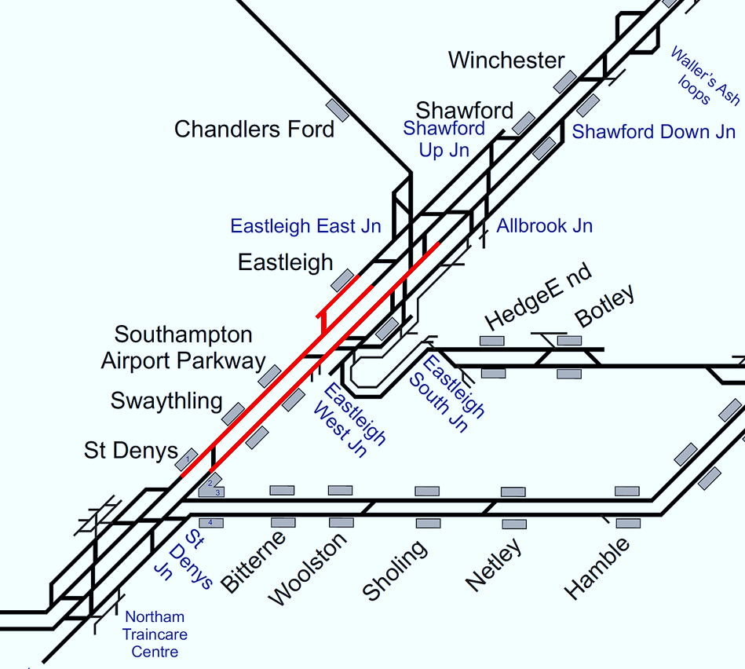
Plan 10.1 Eastleigh - St. Denys
Bournemouth Main Line | Status: All lines blocked Status: (Allbrook to Eastleigh South Junction available)
Principles of Service Alteration
1W xx xx.05 Waterloo - Weymouth & return services run between Southampton and Weymouth. 1Bxx xx.35 Waterloo - Poole & return services Divert via Havant. 2Bxx xx.49 Winchester- Bournemouth & Return run between Southampton Central and Bournemouth only 1Txx xx.09 Waterloo - Portsmouth Harbour (EH) & return services run as booked. 2Rxx xx 48 Salisbury - Romsey and return services run only between Southampton & Salisbury via Test Valley. CrossCountry: 1Oxx (Down) & 1Mxx (Up) services divert between Basingstoke and Southampton Central via Laverstock/Test Valley or services terminate/start Reading. Freight services diverted via Laverstock or Westbury. Bus service Eastleigh - Southampton.
Alternative Passenger Journey
SWR Bus Replacement Passengers via Southern to/from Havant Local Bus
Information for Signallers
See Principles of Service Alteration.
Additional Information for Station Staff
Passenger Ticket acceptance on Southern, Southampton Central to/from Havant and Clapham Junction SWR Bus Replacement fast bus & all stations Southampton Central to Eastleigh and return.
Passenger Information
Local buses. Bus 2 Southampton to Eastleigh every 15 minutes St. Denys (9 minutes), Swaythling 18 minutes and Eastleigh 36 minutes and return. Bus U1A/C Eastleigh to Southampton Central via Southampton Airport and Swaythling, Every 15-20 minutes Eastleigh to Parkway 5 minutes, to Swaythling 10 Minutes, to Southampton Central 35 minutes. And return.

Slide 42
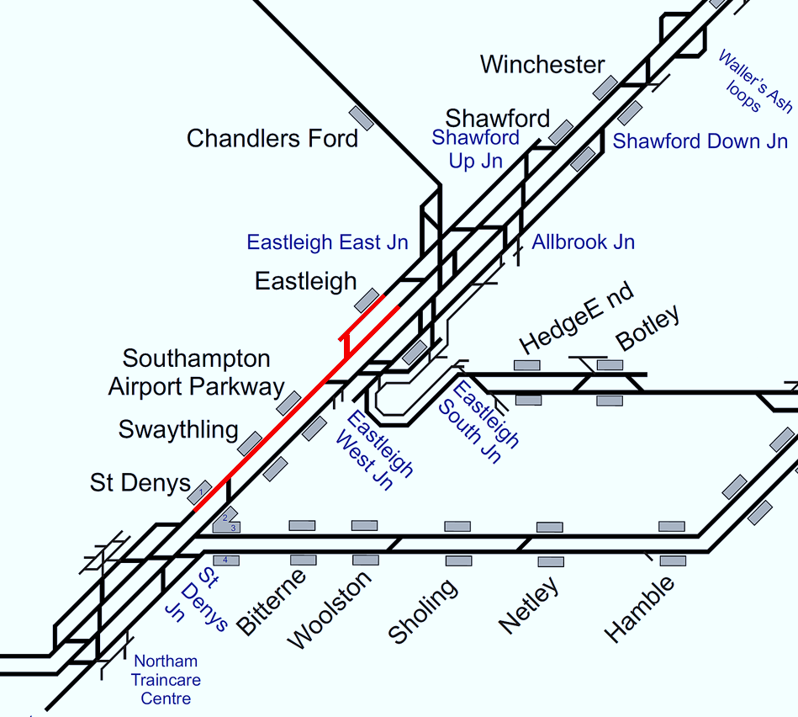
Plan 10.2 Eastleigh - St. Denys
Bournemouth Main Line | Status: Up lines blocked Status: (Allbrook to Eastleigh South Junction available)
Principles of Service Alteration
1Wxx xx.05 Waterloo - Weymouth & Return run between Bournemouth and Weymouth. 1Bxx xx.35 Waterloo - Poole & return services Divert via Havant, (or reverse Fareham) in UP direction only if crew have route knowledge 2Bxx xx.49 Winchester - Bournemouth & return services run between Southampton and Bournemouth. 1Txx xx.09 Waterloo - Portsmouth Harbour (EH) & return services run as booked. 2Rxx xx 56 Salisbury - Romsey and return services run only between Southampton & Salisbury via Test Valley. CrossCountry: 1Mxx (Up) services divert between Basingstoke and Southampton Central via Laverstock/Test Valley in the Up Direction or services terminate/start Reading. Freight services diverted via Laverstock or Westbury in the Up Direction. Bus service Eastleigh - Southampton, running all stations in Up direction, Southampton Parkway only in Down direction.
Alternative Passenger Journey
SWR Bus Replacement Passengers via Southern to/from Havant Local Bus
Information for Signallers
See Principles of Service Alteration.
Additional Information for Station Staff
Passengers Ticket acceptance on Southern, Southampton Central to Havant and Clapham Junction SWR Bus Replacement fast bus & all stations Southampton Central to Eastleigh.
Passenger Information
Local buses. Bus 2 Southampton to Eastleigh every 15 minutes St. Denys ( 9 minutes), Swaythling 18 minutes and Eastleigh 36 minutes and return. Bus U1A/C Eastleigh to Southampton Central via Southampton Airport and Swaythling, Every 15-20 minutes Eastleigh to Parkway 5 minutes, to Swaythling 10 Minutes, to Southampton Central 35 minutes. And return.

Slide 43

Plan 10.3 Eastleigh - St. Denys
Bournemouth Main Line | Status: Down line blocked Status: (Allbrook to Eastleigh South Junction available)
Principles of Service Alteration
1Wxx xx.05 Waterloo - Weymouth & return services run between Bournemouth and Weymouth. 1Bxx xx.35 Waterloo - Poole & return services Divert via Havant, (or reverse Fareham) in DOWN direction only. 2Bxx xx.49 Winchester - Bournemouth & return services run between Southampton Central and Bournemouth. 1Txx xx.09 Waterloo - Portsmouth Harbour (EH) & return services run as booked. 2Rxx xx 48 Salisbury - Romsey and return services run only between Southampton & Salisbury via Test Valley. CrossCountry: 1Oxx (Down) services divert between Basingstoke and Southampton Central via Laverstock/Test Valley in the Down Direction or services terminate/start Reading. Freight services diverted via Andover or Westbury in the Down Direction. Bus service Eastleigh - Southampton, running all stations in Down direction, Southampton Parkway only in Up direction.
Alternative Passenger Journey
SWR Bus Replacement Passengers via Southern to/from Havant Local Bus
Information for Signallers
See Principles of Service Alteration.
Additional Information for Station Staff
Passengers Ticket acceptance on Southern, Havant to Southampton Central SWR Bus Replacement fast bus & all stations Eastleigh to Southampton Central
Passenger Information
Local buses. Bus 2 Southampton to Eastleigh every 15 minutes St. Denys ( 9 minutes), Swaythling 18 minutes and Eastleigh 36 minutes and return. Bus U1A/C Eastleigh to Southampton Central via Southampton Airport and Swaythling, Every 15-20 minutes Eastleigh to Parkway 5 minutes, to Swaythling 10 Minutes, to Southampton Central 35 minutes.

Slide 44
St. Denys
Plan 11 | St. Denys - Southampton Bournemouth Main Line
11.1 | All lines blocked or both lines blocked in one direction (No access to Southampton station and no access to Northam Depot)

Slide 45
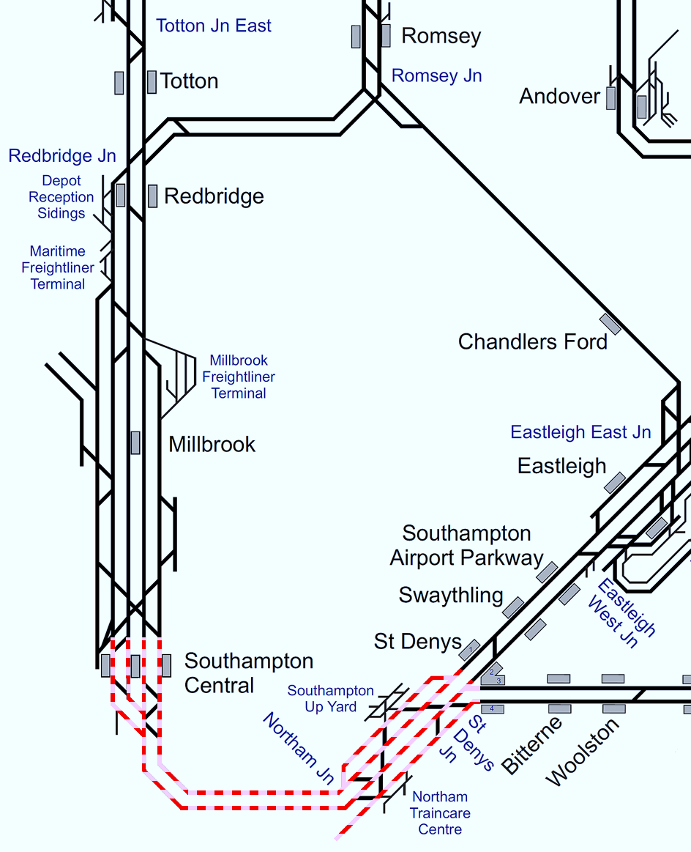
Plan 11.1 St. Denys - Southampton
Bournemouth Main Line | Status: All lines blocked or both lines Status: blocked in one direction (No access to Southampton station and no access to Northam Depot)
Principles of Service Alteration
1Wxx xx.05 Waterloo - Weymouth & return services run between Brockenhurst & Weymouth. 1Bxx xx.35 Waterloo - Poole & return services start/terminate Southampton Airport Parkway or Eastleigh. 2Bxx xx.49 Winchester - Bournemouth & return services run between Southampton Central and Bournemouth 1Txx xx.09 Waterloo - Portsmouth Harbour (EH) & return services run as booked. 2Rxx xx 48 Salisbury - Romsey and return services run only between Southampton & Salisbury via Test Valley. 2Exx xx36 Portsmouth - Southampton & return services run between Portsmouth & St. Denys (if shunt move available), Portsmouth & Woolston (if shunt move not available, & NR MOM is available). If neither shunt move nor NR MOM is available, services cancelled. GTR: 1Jxx services to Southampton Central divert and terminate / start at Fratton. GTR: 1Nxx services terminate/start at Barnham with stock and crew to step up by 2 circuits. From Southampton Central, any stock/crew to berth at Southampton Central Down Bay. (SWR Pilot Driver required for berth at SOU). GWR: Services to divert via Chandlers Ford / Botley if crew knowledge permits or terminate / start at Southampton Central. If no access to Southampton Central and the route via Chandlers Ford is unavailable then GWR to terminate at Salisbury. Control discuss with GWR crew requirements. CrossCountry: 1Oxx (Down) & 1Mxx (Up) services divert between Basingstoke and Southampton Central via Laverstock/Test Valley or services terminate/start reading. Bus service Southampton Pkwy - Bournemouth (fast) & Southampton Pkwy - Brockenhurst (all stations). If trains unable to reverse at St. Denys, Bus service from Fareham.
Alternative Passenger Journey
SWR Bus replacement / Local buses.
Information for Signallers
See Principals of Service Alteration.
Additional Information for Station Staff
SWR bus replacement, Fast Bus Fareham to Southampton Central, Slow bus all stations. Fast and Slow Bus Eastleigh to Southampton Central and all stations to Brockenhurst Fast Service Eastleigh, Southampton Airport to Bournemouth.
Passenger Information
Local buses. 406 Bursledon, Hamble, Netley, Woolston, Sholing, Bitterne. Mon dep 1055. Tue - Fri 0855 and 1530 9 Southampton, Woolston, Sholing, Bitterne (every 30 minutes) 6 Sholing to Netley, Hamble and Bursledon or Sholing to Southampton, Woolston (every 30 minutes) X4,X5 Fareham to Bursledon, Sholing and Woolston X4/X5 both every 30 minutes. Bus 2 Southampton to Eastleigh every 15 minutes St. Denys ( 9 minutes), Swaythling 18 minutes and Eastleigh 36 minutes. Brockenhurst to Southampton Bus 6 @ 0645,0856,1008 then Hourly until 1408,1553,1751 calling at Ashurst (18 minutes) Totton (40 minutes) Redbridge (45 minutes) Millbrook (48 minutes) Southampton Central (55 minutes) Southampton Central Bus 6 @ 0905,1025 then Hourly to 1725,1854 Millbrook (10 minutes) Redbridge (12 minutes) Totton (17 minutes) Ashurst (35 Minutes) Brockenhurst (50 minutes) Beaulieu Road No Bus Totton to Southampton Central via Redbridge & Millbrook and 6,8,11,12,X7, X7R every 5 minutes Redbridge (5 minutes) Millbrook (8 minutes) Southampton Central (15 minutes).

Slide 46
Plan 11.2 St. Denys - Southampton
Bournemouth Main Line | Status: One line available through Southampton Tunnel Bi-directional signalling available
Principles of Service Alteration
Single line working over either line through Southampton Tunnel. Capacity agreed with Eastleigh SSM is 7 trains per hour. 1Wxx xx.05 Waterloo - Weymouth & return services run as booked. 1Bxx xx.35 Waterloo - Poole & return services run as booked 2Bxx xx.49 Winchester - Bournemouth & return services run between Southampton Central and Bournemouth 2Rxx xx 56 Salisbury - Romsey and return services run as booked 2Exx xx36 Portsmouth - Southampton & return services run as booked GTR: 1Jxx services to Southampton Central terminate / start at Fareham. GTR: 1Nxx services terminate/start at Barnham with stock and crew to step up by 2 circuits. From Southampton Central, any stock/crew to berth at Southampton Central Down Bay. (SWR Pilot Driver required for berth at SOU). GWR: Services to divert via Chandlers Ford / Botley if crew knowledge permits or terminate / start at Southampton Central. If no access to Southampton Central and the route via Chandlers Ford is unavailable then GWR to terminate at Salisbury. Control discuss with GWR crew requirements. CrossCountry: 1Oxx (Down) & 1Mxx (Up) services run as booked. Freight services to discuss with FOC as to diversion options via Romsey and Andover. If capacity needs to be freed up then consider terminating 2Exx services at St Denys with hold for connection into 2Sxx services or SSO for 1Bxx service.
Alternative Passenger Journey
SWR Bus replacement / Local buses.
Information for Signallers
See Principals of Service Alteration.
Additional Information for Station Staff
SWR bus replacement, Fast Bus Fareham to Southampton Central, Slow bus all stations. Fast and Slow Bus Eastleigh to Southampton Central and all stations to Brockenhurst Fast Service Eastleigh, Southampton Airport to Bournemouth.
Passenger Information
Local buses. 406 Bursledon, Hamble, Netley, Woolston, Sholing, Bitterne. Mon dep 1055. Tue - Fri 0855 and 1530 9 Southampton, Woolston, Sholing, Bitterne (every 30 minutes) 6 Sholing to Netley, Hamble and Bursledon or Sholing to Southampton, Woolston (every 30 minutes) X4,X5 Fareham to Bursledon, Sholing and Woolston X4/X5 both every 30 minutes. Bus 2 Southampton to Eastleigh every 15 minutes St. Denys ( 9 minutes), Swaythling 18 minutes and Eastleigh 36 minutes. Brockenhurst to Southampton Bus 6 @ 0645,0856,1008 then Hourly until 1408,1553,1751 calling at Ashurst (18 minutes) Totton (40 minutes) Redbridge (45 minutes) Millbrook (48 minutes) Southampton Central (55 minutes) Southampton Central Bus 6 @ 0905,1025 then Hourly to 1725,1854 Millbrook (10 minutes) Redbridge (12 minutes) Totton (17 minutes) Ashurst (35 Minutes) Brockenhurst (50 minutes) Beaulieu Road No Bus Totton to Southampton Central via Redbridge & Millbrook and 6,8,11,12,X7, X7R every 5 minutes Redbridge (5 minutes) Millbrook (8 minutes) Southampton Central (15 minutes).

Slide 47
St. Denys
Plan 12 | St. Denys - Southampton Bournemouth Main Line
12.1 | All lines blocked or both lines blocked in one direction (Access to Southampton station but no access to Northam Depot)

Slide 48
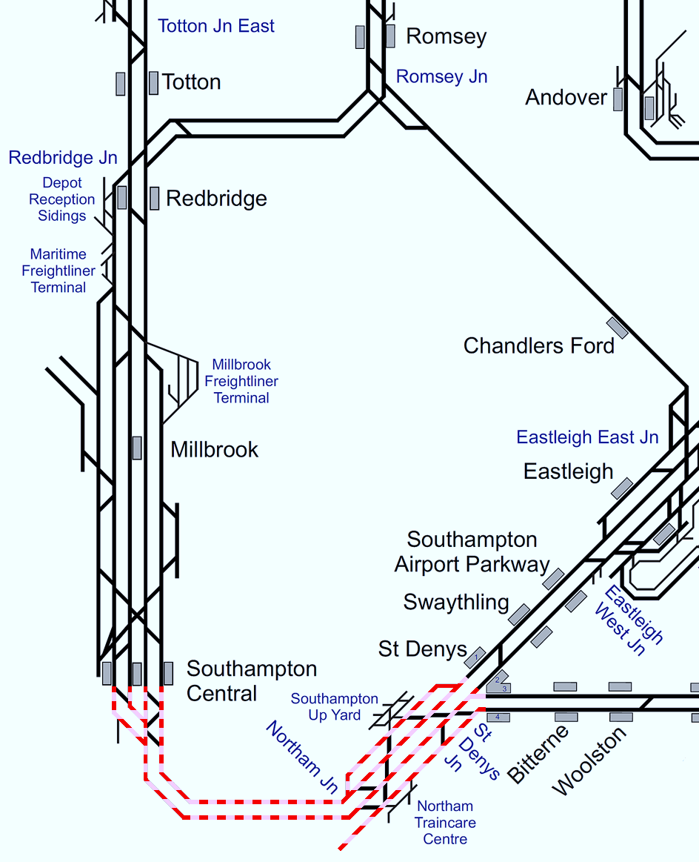
Plan 12.1 St. Denys - Southampton
Bournemouth Main Line | Status: All lines blocked or both lines Status: blocked in one direction (Access to Southampton station but no access to Northam Depot)
Principles of Service Alteration
1Wxx xx.05 Waterloo - Weymouth & return services Cancelled From Waterloo. run between Southampton & Weymouth. (SSO Branksome & Parkstone) 1Bxx xx.35 Waterloo - Poole & return run between Waterloo & Southampton Airport Parkway. (SSO Shawford) 2Bxx xx.49 Winchester - Bournemouth & return services run Southampton Central to Bournemouth only 1Txx xx.09 Waterloo - Portsmouth Harbour (EH) & return services run as booked. 2Rxx xx 48 Salisbury - Romsey and return services run only between Southampton & Salisbury via Test Valley. 2Exx xx. Portsmouth - Southampton & return services run between Portsmouth & St. Denys (if shunt move available), Portsmouth and Woolston (if shunt move not available, & NR MOM is available). If neither shunt move nor NR MOM is available, services cancelled. GTR: 1Jxx services to Southampton Central divert and terminate / start at Fratton. GTR: 1Nxx services terminate/start at Barnham with stock and crew to step up by 2 circuits. From Southampton Central, any stock/crew to berth at Southampton Central Down Bay. (SWR Pilot Driver required for berth at SOU). GWR: Services to divert via Chandlers Ford / Botley if crew knowledge permits or terminate / start at Southampton Central. Control discuss with GWR crew requirements. CrossCountry: 1Oxx (Down) & 1Mxx (Up) services divert between Basingstoke and Southampton Central via Laverstock/Test Valley or services terminate/start Reading. Freight services divert via Andover. Bus services Eastleigh - Southampton (fast and all stations). If trains unable to reverse at St. Denys, bus service from termination point of Portsmouth services to/from Southampton.
Alternative Passenger Journey
SWR bus replacement / local buses.
Information for Signallers
See Principles of Service Alteration.
Additional Information for Station Staff
SWR bus replacement, Fast Bus Fareham to Southampton Central, Slow bus all stations. Fast and Slow Bus Eastleigh to Southampton Central.
Passenger Information
Local buses. 406 Bursledon Hamble Netley Woolston Sholing Bitterne. Monday dep @ 1055. Tuesday - Friday 0855 and 1530. 9 Southampton, Woolston, Sholing, Bitterne (every 30 minutes). 6 Sholing to Netley, Hamble and Bursledon or Sholing to Southampton, Woolston (every 30 minutes). X4,X5 Fareham to Bursledon, Sholing and Woolston X4/X5 both every 30 minutes. Bus 2 Southampton to Eastleigh every 15 minutes St. Denys (9 minutes), Swaythling 18 minutes and Eastleigh 36 minutes.

Slide 49
Southampton
Plan 13 | Southampton - Redbridge / Totton Bournemouth Main Line
13.1 | All lines blocked
13.2 | One line blocked

Slide 50
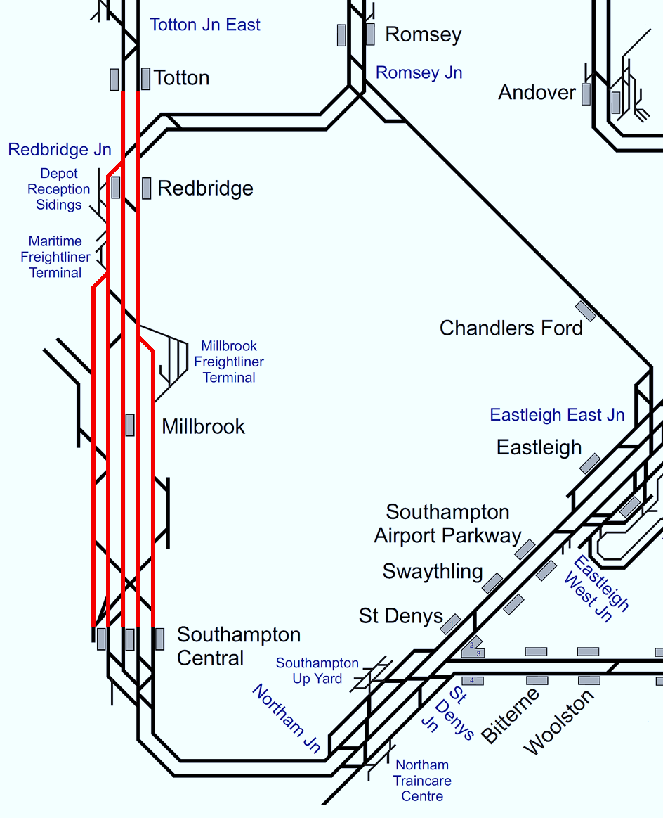
Plan 13.1 Southampton - Redbridge / Totton
Bournemouth Main Line | Status: All lines blocked
Principles of Service Alteration
1Wxx xx.05 Waterloo - Weymouth & return services run between Brockenhurst and Weymouth. (SSO Branksome & Parkstone) 1Bxx xx.35 Waterloo - Poole & return services run between Waterloo and Southampton. (SSO Shawford) 2Bxx xx.49 Winchester – Bournemouth services cancelled. Stock to berth at Bournemouth and Southampton 2Rxx xx.56 Salisbury - Romsey and return services run only between between Salisbury and Southampton via Chandlers Ford. GWR: Services divert via Eastleigh / Chandlers Ford if crew knowledge permits. If not terminate at Salisbury and form 1Fxx services departing Salisbury at xx:42. CrossCountry: 1Oxx (Down) & 1Mxx (Up) services terminate / start at Southampton Central (if capacity at Southampton is a risk terminate / start at Reading). Freight services divert via Eastleigh if practical.
Alternative Passenger Journey
SWR bus replacement. Local buses.
Information for Signallers
See Principles of Service Alteration.
Additional Information for Station Staff
SWR Bus replacement. Fast bus Southampton to Bournemouth. Slow Bus all stations Southampton Central to Brockenhurst.
Passenger Information
Local buses. Brockenhurst to Southampton Bus 6 @ 0645,0856,1008 then Hourly until 1408,1553,1751 calling at Ashurst (18 minutes) Totton (40 minutes) Redbridge (45 minutes) Millbrook (48 minutes) Southampton Central (55 minutes) Southampton Central Bus 6 @ 0905,1025 Then Hourly to 1725,1854 Millbrook (10 minutes) Redbridge (12 minutes) Totton (17 minutes) Ashurst (35 Minutes) Brockenhurst (50 minutes) Beaulieu Road No Bus. Totton to Southampton Central via Redbridge & Millbrook and 6,8,11,12,X7, X7R every 5 minutes Redbridge (5 minutes) Millbrook (8 minutes) Southampton Central (15 minutes).

Slide 51
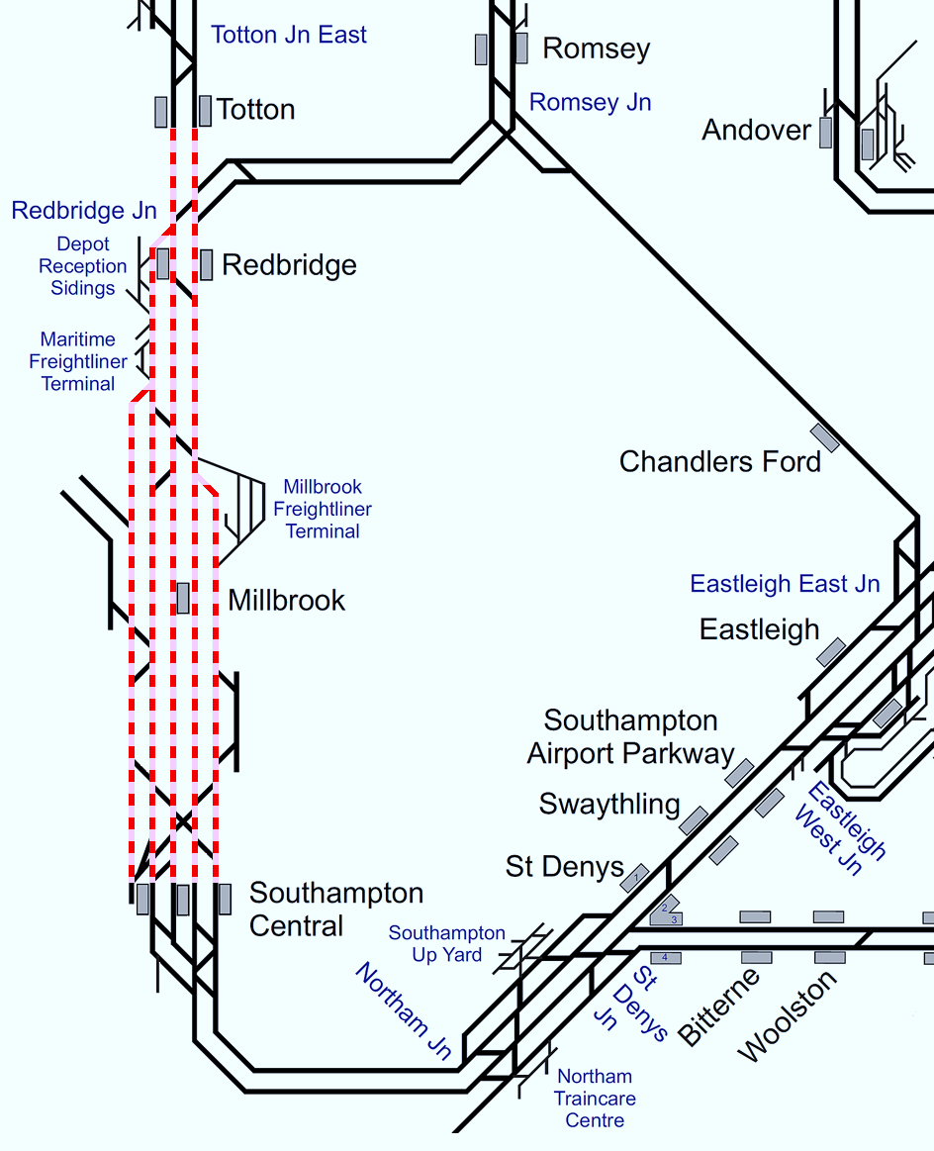
Plan 13.2 Southampton - Redbridge / Totton
Bournemouth Main Line | Status: One line blocked (in either direction)
Principles of Service Alteration
If Single Line Working can be implemented. 1Wxx xx.05 Waterloo - Weymouth & return services run under SLW arrangements. 1Bxx xx.35 Waterloo - Poole & return services run under SLW arrangements.(SSO Shawford) 2Bxx xx.49 Winchester - Bournemouth & return service cancelled. Stock to berth at Bournemouth and Southampton Goods loop. 2Rxx xx 56 Salisbury - Romsey and return services run only between Salisbury and Southampton Central via Chandlers Ford. 1Wxx xx35 service to call all stations Southampton to Brockenhurst. GWR: Services divert via Eastleigh / Chandlers Ford if crew knowledge permits. If not terminate at Salisbury and form 1Fxx services departing Salisbury at xx:42. CrossCountry: 1Oxx (Down) & 1Mxx (Up) services terminate / start at Southampton Central (if capacity at Southampton is a risk terminate / start at Reading). Freight services divert via Eastleigh if practical. If Single Line Working not available use Plan 13.1 for all lines blocked.
Alternative Passenger Journey
SWR bus replacement. Local buses.
Information for Signallers
See Principles of Service Alteration.
Additional Information for Station Staff
SWR Bus replacement. Fast bus Southampton to Bournemouth. Slow Bus all stations Southampton Central to Brockenhurst.
Passenger Information
Local buses. Brockenhurst to Southampton Bus 6 @ 0645,0856,1008 then Hourly until 1408,1553,1751 calling at Ashurst (18 minutes) Totton (40 minutes) Redbridge (45 minutes) Millbrook (48 minutes) Southampton Central (55 minutes) Southampton Central Bus 6 @ 0905,1025 Then Hourly to 1725,1854 Millbrook (10 minutes) Redbridge (12 minutes) Totton (17 minutes) Ashurst (35 Minutes) Brockenhurst (50 minutes) Beaulieu Road No Bus Totton to Southampton Central via Redbridge & Millbrook and 6,8,11,12,X7, X7R every 5 minutes Redbridge (5 minutes) Millbrook (8 minutes) Southampton Central (15 minutes).

Slide 52
Redbridge / Totton
Plan 14 | Redbridge / Totton - Brockenhurst Bournemouth Main Line
14.1 | All lines blocked
14.2 | One line blocked

Slide 53
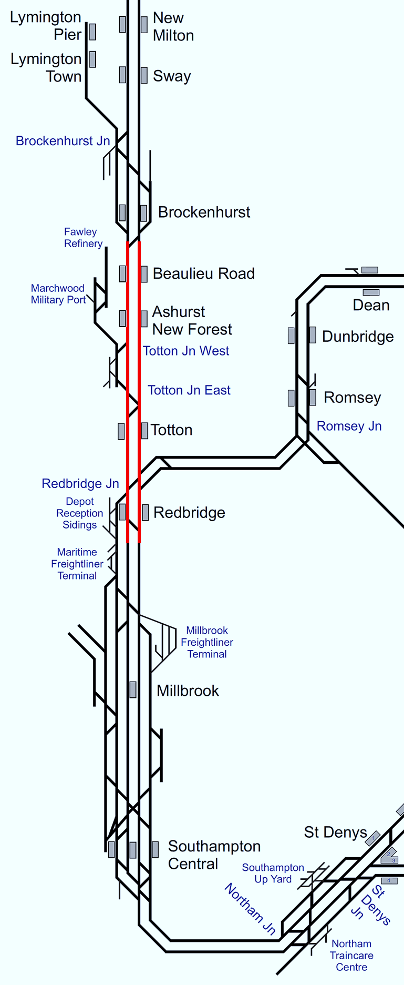
Plan 14.1 Redbridge / Totton - Brockenhurst
Bournemouth Main Line | Status: All lines blocked
Principles of Service Alteration
1Wxx xx.05 Waterloo - Weymouth & return services run between Brockenhurst and Weymouth. (SSO Branksome & Parkstone) 1Bxx xx.35 Waterloo - Poole & return services run between Waterloo & Southampton (SSO Shawford) 2Bxx xx.49 Winchester - Bournemouth & return services Cancelled throughout. Stock to berth at Bournemouth and Southampton Goods Loop CrossCountry: 1Oxx (Down) & 1Mxx (Up) services terminate / start at Southampton Central (if Capacity at Southampton is a risk terminate / start at Reading). Fast and slow bus services Southampton area - Brockenhurst and Bournemouth.
Alternative Passenger Journey
SWR bus replacement. Local buses.
Information for Signallers
See Principles of Service Alteration.
Additional Information for Station Staff
SWR Bus replacement. Fast bus Southampton to Bournemouth. Slow Bus all stations Southampton Central to Brockenhurst.
Passenger Information
Local buses. Brockenhurst to Southampton Bus 6 @ 0645,0856,1008 then Hourly until 1408,1553,1751 calling at Ashurst (18 minutes) Totton (40 minutes) Redbridge (45 minutes) Millbrook (48 minutes) Southampton Central (55 minutes) Southampton Central Bus 6 @ 0905,1025 Then Hourly to 1725,1854 Millbrook (10 minutes) Redbridge (12 minutes) Totton (17 minutes) Ashurst (35 Minutes) Brockenhurst (50 minutes) Beaulieu Road No Bus Totton to Southampton Central via Redbridge & Millbrook and 6,8,11,12,X7, X7R every 5 minutes Redbridge (5 minutes) Millbrook (8 minutes) Southampton Central (15 minutes).

Slide 54
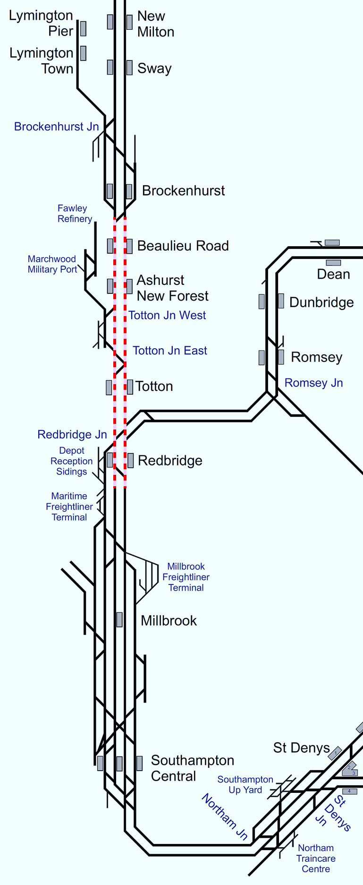
Plan 14.2 Redbridge / Totton - Brockenhurst
Bournemouth Main Line | Status: One line blocked (in either direction)
Principles of Service Alteration
If Single Line Working available: 1Wxx xx.35 Waterloo - Weymouth run under SLW arrangements (if practical.) call all stations to Brockenhurst. (SSO Branksome & Parkstone) 1Bxx xx.05 Waterloo - Poole & return services run between Waterloo and Southampton. (SSO Shawford) 2Bxx xx.49 Winchester – Bournemouth & return Cancelled throughout. Stock to berth at Bournemouth and Southampton Good loop CrossCountry: 1Oxx (Down) & 1Mxx (Up) services terminate / start at Southampton Central (if Capacity at Southampton is a risk terminate / start at Reading). If Single Line Working not available use Plan 14.1 for all lines blocked.
Alternative Passenger Journey
Local buses. SWR bus replacement.
Information for Signallers
See Principles of Service Alteration.
Additional Information for Station Staff
SWR Bus replacement. Fast bus Southampton to Bournemouth. Slow Bus all stations Southampton Central to Brockenhurst.
Passenger Information
Local buses. Brockenhurst to Southampton Bus 6 @ 0645,0856,1008 then Hourly until 1408,1553,1751 calling at Ashurst (18 minutes) Totton (40 minutes) Redbridge (45 minutes) Millbrook (48 minutes) Southampton Central (55 minutes) Southampton Central Bus 6 @ 0905,1025 Then Hourly to 1725,1854 Millbrook (10 minutes) Redbridge (12 minutes) Totton (17 minutes) Ashurst (35 Minutes) Brockenhurst (50 minutes) Beaulieu Road No Bus. Totton to Southampton Central via Redbridge & Millbrook and 6,8,11,12,X7, X7R every 5 minutes Redbridge (5 minutes) Millbrook (8 minutes) Southampton Central (15 minutes).

Slide 55
Brockenhurst
Plan 15 | Brockenhurst - Bournemouth Bournemouth Main Line
15.1 | Both lines blocked | ✔
15.2 | One line blocked | ✔

Slide 56
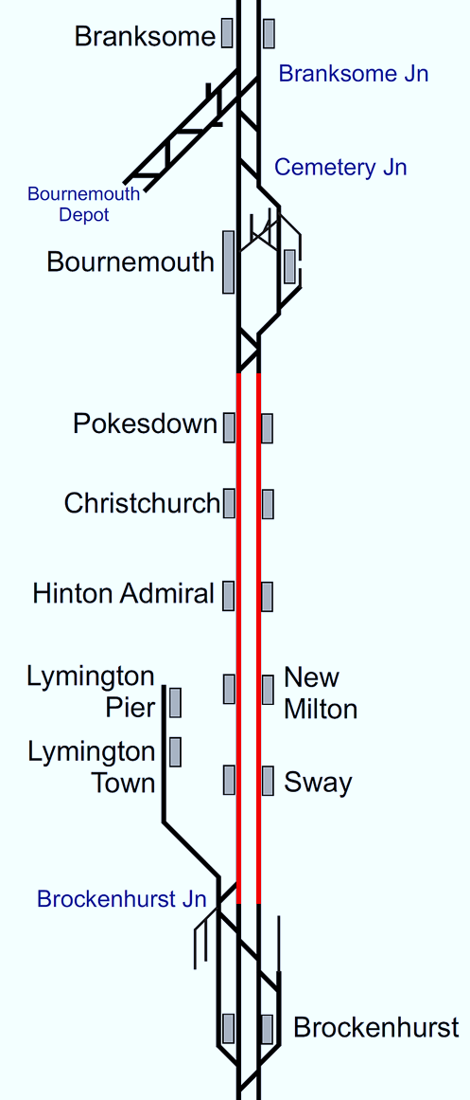
Plan 15.1 Brockenhurst - Bournemouth
Bournemouth Main Line | Status: Both lines blocked
Principles of Service Alteration
1Wxx xx.05 Waterloo - Weymouth & return services run between Bournemouth and Weymouth Only. (SSO Branksome & Parkstone) 1Bxx xx.35 Waterloo - Poole & return services run between Waterloo & Brockenhurst. (Consider SSO for Totton, Ashurst NF and Beaulieu Rd. 2Bxx xx.49 Winchester - Bournemouth & return services Cancelled throughout. Stock to berth at Southanpton and Bournemouth CrossCountry: 1Oxx (Down) & 1Mxx (Up) services terminate / start at Southampton Central (Run to Brockenhurst if not served by SWR and Crew PNB arrangements permit). Provide shuttle train service between Bournemouth and Weymouth in timings of 1Wxx xx35 Waterloo/xx.03 Weymouth.
Alternative Passenger Journey
Fast bus services Southampton Airport Parkway - Bournemouth. Slow Bus from Southampton Central to Sway, New Milton, Hinton Admiral, Christchurch, Pokesdown and Bournemouth. Slow Bus runs all stations Brockenhurst to Bournemouth.
Information for Signallers
1Wxx terminate Southampton Central. 2Bxx terminate Brockenhurst. Cross country terminate Southampton Central (may extend to Brockenhurst subject to crew). Bournemouth to Weymouth Shuttle.
Additional Information for Station Staff
Passengers for Bournemouth and beyond should change at Southampton Airport Parkway for Fast Bus to Bournemouth. Passengers for Brockenhurst to Sway, New Milton, Hinton Admiral Christchurch, Pokesdown and Bournemouth change at Brockenhurst for all stations Bus from Brockenhurst to Bournemouth.
Passenger Information
Local buses. Bournemouth to Pokesdown Bus 2 Every 15 minutes, Journey 15 minutes. Bournemouth for Christchurch and New Milton x1 and x2 Both hourly 35 minutes and 80 minutes. Bournemouth for Christchurch Bus 1 every 7-15 minutes journey 35 minutes Hinton Admiral for Christchurch, New Milton and Bournemouth buses x1 and x2 both hourly, 10 minute walk to bus stop. Christchurch 28 minutes, Bournemouth 65 minutes, New Milton 17 minutes Sway to New Milton C32/C33 infrequent 4 buses 35 minutes (must book) small bus Brockenhurst no bus routes towards Bournemouth (summer tour bus to New Milton).

Slide 57
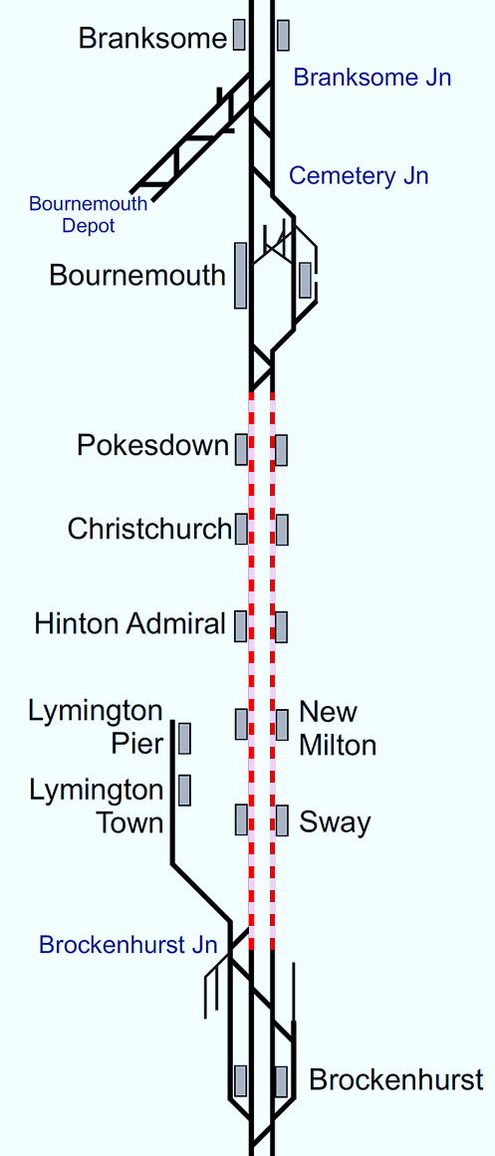
Plan 15.2 Brockenhurst - Bournemouth
Bournemouth Main Line | Status: One line blocked (in either direction)
Principles of Service Alteration
If Single Line Working can be implemented: 1Wxx xx.05 Waterloo - Weymouth & return runs between Bournemouth and Weymouth. 1Bxx xx.35 Waterloo - Poole & return services (run under SLW arrangements) and calls additionally at Shawford. Trains not to call between Brockenhurst and Bournemouth for SLW 2Bxx xx.49 Winchester - Poole & return cancelled throughout. Stock to berth at Bournemouth and Southampton Goods loop CrossCountry: 1Oxx (Down) & 1Mxx (Up) services terminate / start at Southampton Central (Run to Brockenhurst if not served by SWR (Run to Brockenhurst if not served by SWR and Crew PNB arrangements permit). If Single Line Working not available use Plan 15.1 for both lines blocked.
Alternative Passenger Journey
Fast bus services Southampton Airport Parkway - Bournemouth. Slow Bus from Southampton Central to Sway, New Milton, Hinton Admiral, Christchurch, Pokesdown and Bournemouth Slow Bus runs all stations Brockenhurst to Bournemouth.
Information for Signallers
See Principles of Service Alteration. If SLW impractical Terminate 1Wxx xx35 Waterloo to Weymouth and return terminates at Southampton Central.
Additional Information for Station Staff
Passengers for Bournemouth and beyond should change at Southampton Airport Parkway for Fast Bus to Bournemouth. Passengers for Brockenhurst to Sway, New Milton, Hinton Admiral Christchurch, Pokesdown and Bournemouth change at Brockenhurst for all stations Bus from Brockenhurst to Bournemouth.
Passenger Information
Local buses. Bournemouth to Pokesdown Bus 2 Every 15 minutes, Journey 15 minutes. Bournemouth for Christchurch and New Milton x1 and x2 Both hourly 35 minutes and 80 minutes. Bournemouth for Christchurch Bus 1 every 7-15 minutes journey 35 minutes Hinton Admiral for Christchurch, New Milton and Bournemouth buses x1 and x2 both hourly, 10 minute walk to bus stop. Christchurch 28 minutes, Bournemouth 65 minutes, New Milton 17 minutes Sway to New Milton C32/C33 infrequent 4 buses 35 minutes (must book) small bus Brockenhurst no bus routes towards Bournemouth (summer tour bus to New Milton).

Slide 58
Bournemouth
Plan 16 | Bournemouth - Poole Bournemouth Main Line
16.1 | One or both lines blocked | ✔

Slide 59
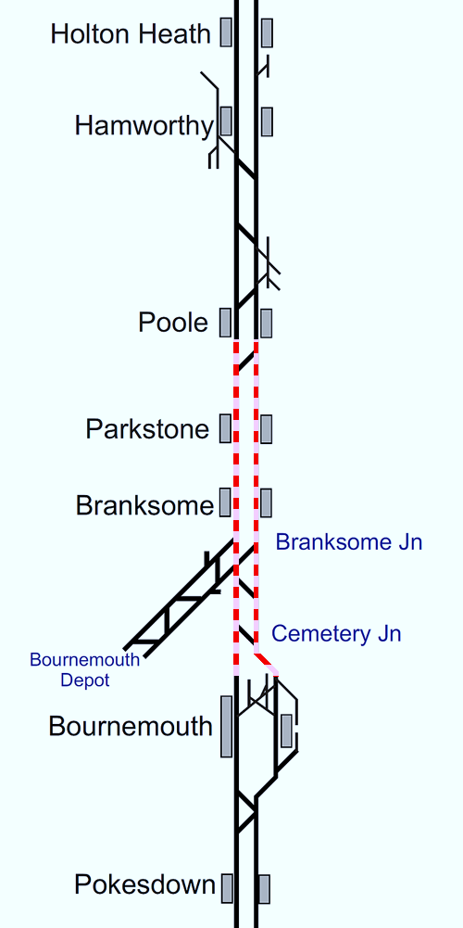
Plan 16.1 Bournemouth - Poole
Bournemouth Main Line | Status: One or both lines blocked
Principles of Service Alteration
1Wxx xx.05 Waterloo - Weymouth & return services run between Waterloo and Bournemouth and Poole and Weymouth. 1Bxx xx.35 Waterloo - Poole & return services run between Waterloo and Bournemouth. Bus service between Bournemouth and Poole.
Alternative Passenger Journey
All Down trains terminate at Bournemouth. Shuttle service between Poole and Weymouth. (if Poole not available Shuttle Wareham to Weymouth). Fast and slow Bus service between Bournemouth and Poole. Local buses.
Information for Signallers
See Principles of Service Alteration. Shuttle service Poole to Weymouth (if Poole available) or Wareham to Weymouth Any trapped services hold in stations where possible.
Additional Information for Station Staff
SWR Bus replacement Fast bus from Bournemouth to Poole and return. (if Poole not Available) Run Bournemouth, Poole, Wareham only. Slow bus Bournemouth to Poole (if Poole not available extend to Wareham).
Passenger Information
Local buses. Passengers at Poole for Bournemouth Bus 1,1c,m1,m2 every 10 minutes 32-35 minutes Passengers at Poole for Parkstone Bus 1,1c,m1,m2 every 10 minutes journey 10 minutes Passengers at Poole to Branksome Bus 1,1c,m1 m2 every 10 minutes Journey 16 minutes.

Slide 60
Poole
Plan 17 | Poole - Wareham Bournemouth Main Line
17.1 | One or both lines blocked | ✔

Slide 61
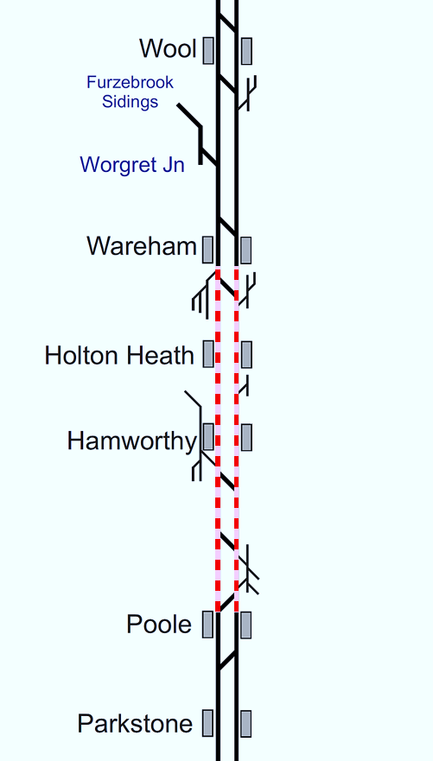
Plan 17.1 Poole - Wareham
Bournemouth Main Line | Status: One or both lines blocked
Principles of Service Alteration
1Wxx xx.05 Waterloo - Weymouth & return services run Waterloo to Bournemouth and Wareham to Weymouth. If stock available, shuttle service between Wareham and Weymouth (or Wool to Weymouth).
Alternative Passenger Journey
If stock available, shuttle service between Wareham and Weymouth. Fast bus service between Bournemouth and Wareham. (Note: if no train service Wareham - Weymouth, bus to run Bournemouth - Weymouth.) Slow bus service between Poole and Wareham or Poole to Weymouth.
Information for Signallers
1Wxx xx.05 Waterloo - Weymouth & return services run Waterloo to Bournemouth and Wareham to Weymouth. 1Wxx xx.35 Waterloo - Weymouth terminate/start Poole. If stock available, shuttle service between Wareham and Weymouth (or Dorchester South to Weymouth).
Additional Information for Station Staff
Shuttle service Weymouth to Wareham (or Wareham to Dorchester South if Wareham not available). Train Shuttle service 1Wxx Wareham to Weymouth (or Wool to Weymouth if Wareham not available). Fast bus service between Bournemouth and Wareham. (Note: if no train service Wareham - Weymouth, bus to run Bournemouth, Wareham (Wool. if shuttle from Wool), Dorchester and Weymouth.) Slow bus service between Poole and Wareham/Wool or Poole to Weymouth.
Passenger Information
Local buses. Passengers at Wareham for Poole and return, bus 40 and X54, Hourly Journey time 30-35 minutes Passengers at Hamworthy to Poole buses 8,9 and X54 every 15 minutes journey time 20 minutes.

Slide 62
Wareham
Plan 18 | Wareham - Dorchester South Bournemouth Main Line
18.1 | One or both lines blocked

Slide 63
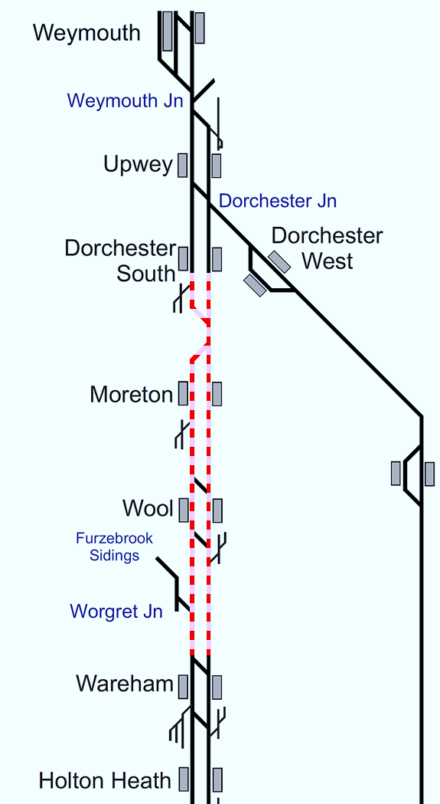
Plan 18.1 Wareham - Dorchester South
Bournemouth Main Line | Status: One or both lines blocked
Principles of Service Alteration
1Wxx xx.05 Waterloo - Weymouth & return services run between Waterloo and Wareham. If stock available, shuttle service between Dorchester South and Weymouth.
Alternative Passenger Journey
SWR Bus service between Wareham and Dorchester South/Weymouth. Local buses.
Information for Signallers
See Principles of Service Alteration.
Additional Information for Station Staff
If no Weymouth - Dorchester Shuttle available use Bus 10 or GWR Dorchester West to Weymouth. Bus Replacement to run between Wareham and Dorchester South if Shuttle in place or Wareham to Weymouth if no shuttle available.
Passenger Information
Local buses. Weymouth, Upwey and Dorchester Bus 10 (every 13 minutes) journey time 14 minutes to Upwey and Dorchester 22- 27 minutes Weymouth to Wareham bus X54 depart @ 0748,1000,1230,1645. Wool 30-50 minutes later, Wareham 56-69 minutes later also runs to Hamworthy and Poole Wareham to Weymouth X54 departs Wareham @ 1011,1246,1507,1911. Wool 16 minutes later. Weymouth 76 minutes later Moreton no local buses Holton Heath to Wareham and Poole Bus 40, hourly service Poole to Holton Heath 23 minutes, Holton Health to Wareham 9 minutes.

Slide 64
Dorchester South
Plan 19 | Dorchester South - Weymouth Bournemouth Main Line
19.1 | One or both lines blocked | ✔

Slide 65
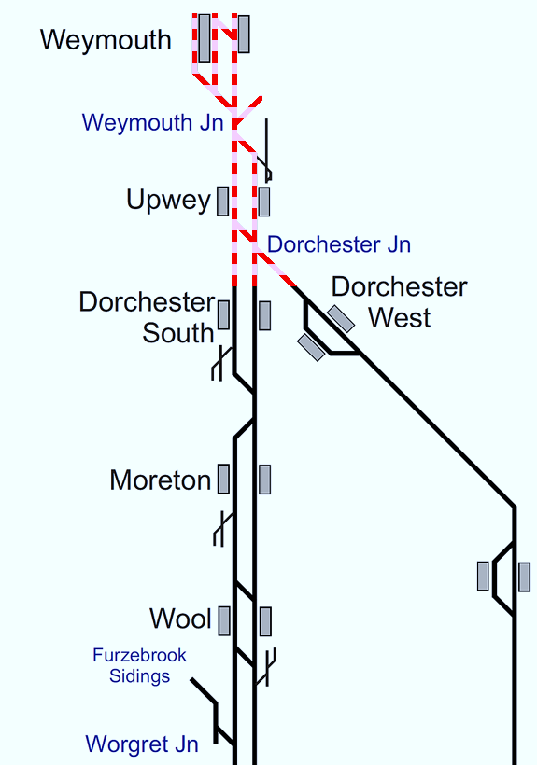
Plan 19.1 Dorchester South - Weymouth
Bournemouth Main Line | Status: One or both lines blocked
Principles of Service Alteration
1Wxx xx.05 Waterloo - Weymouth & return Terminate/Start Dorchester South. GWR: Services terminate Dorchester West.
Alternative Passenger Journey
Bus service between Dorchester South, Dorchester West and Weymouth. Dorchester West for GWR passengers.
Information for Signallers
See Principles of Service Alteration.
Additional Information for Station Staff
N/A
Passenger Information
Local buses. Weymouth, Upwey and Dorchester Bus 10 (every 13 minutes) journey time 14 minutes to Upwey and Dorchester 22- 27 minutes SWR Rail replacement bus.

